Slide 1



Nursery September 2021
September 2020

Slide 2


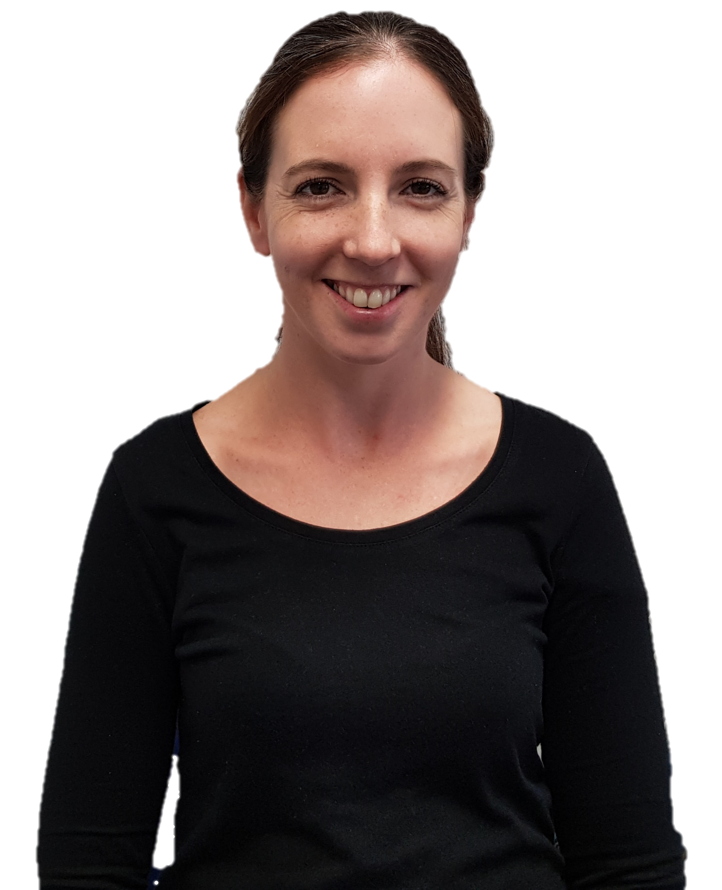
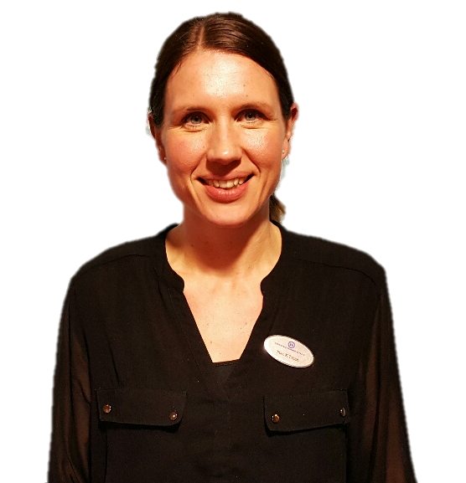
Meet The Staff
Mrs Atkinson
Teaching Assistant
Mrs Rayner
Class Teacher
Mrs Tyler
Class Teacher

Slide 3
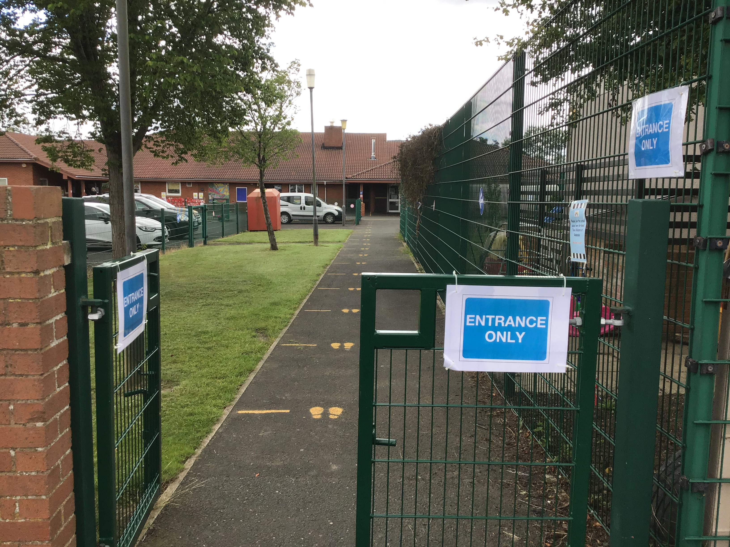
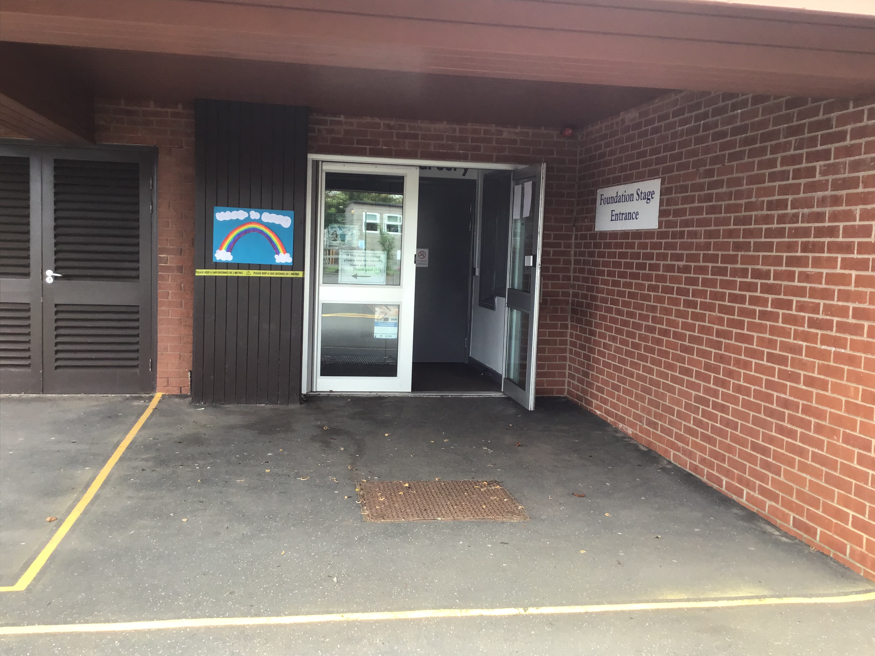
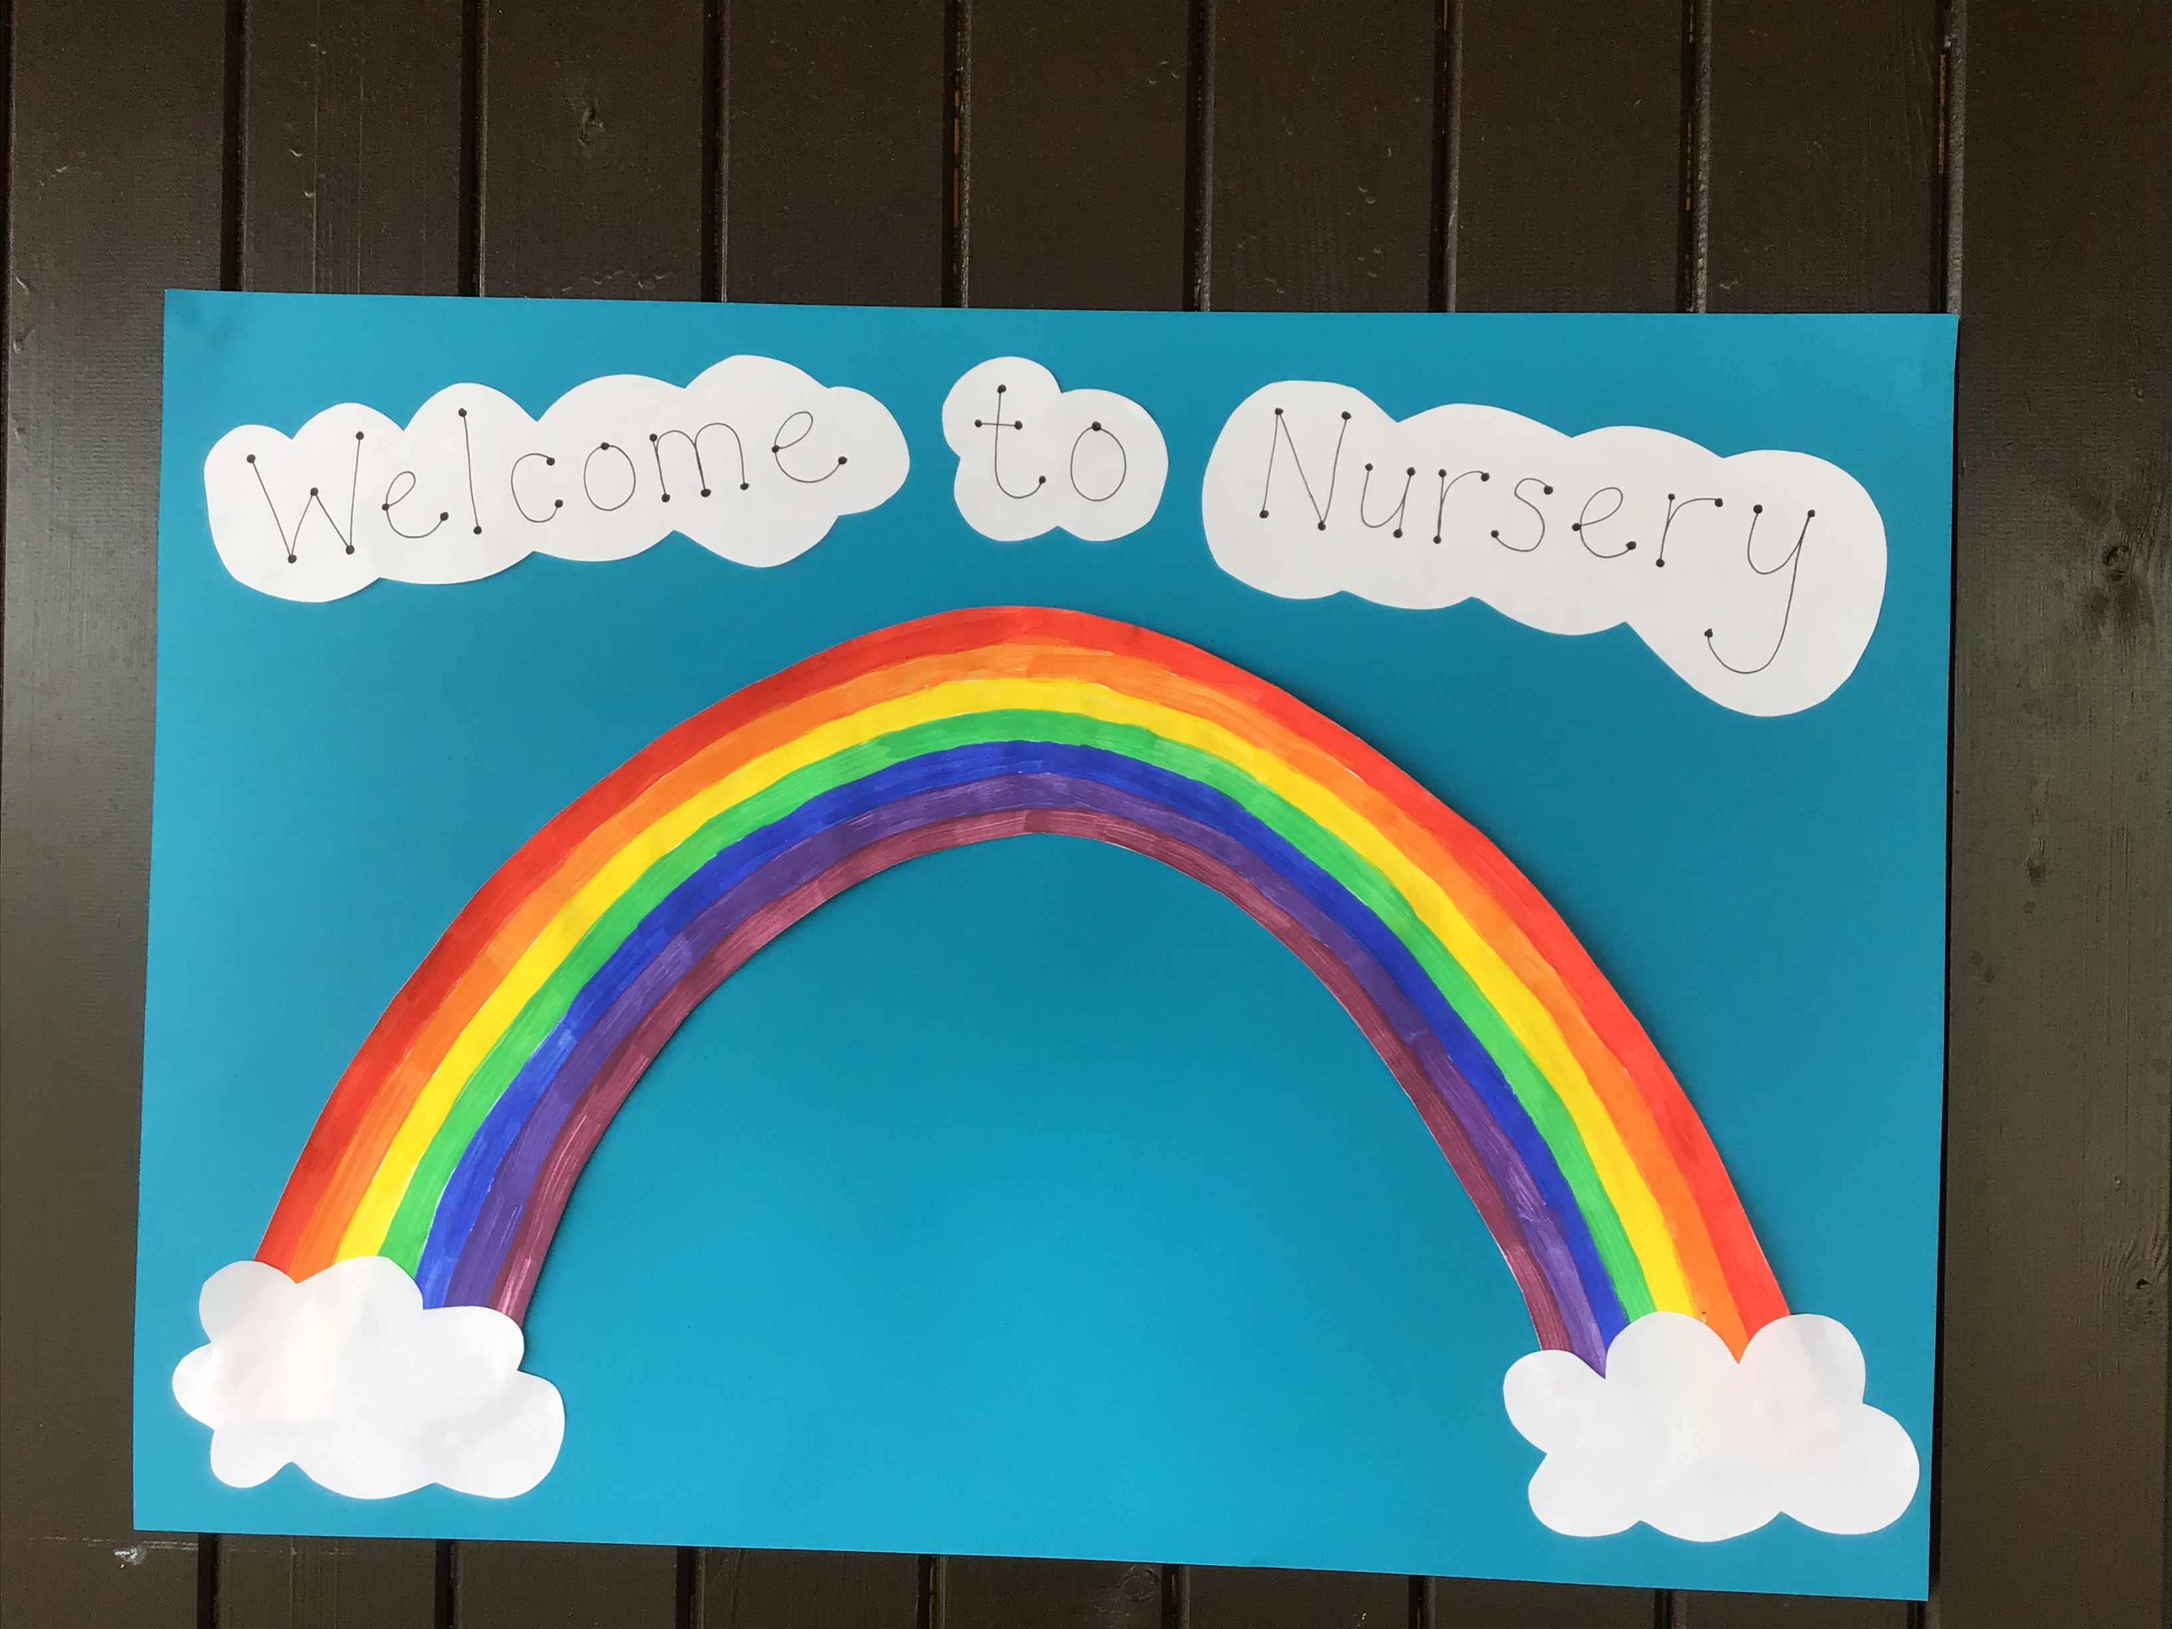
Arrival & Collection
Enter the school grounds near B&M.
Look for the rainbow sign and you will know you have found us!

Slide 4
Start & Finish Times
You should have already received your staggered start time for Thursday 2nd and Friday 3rd September.
Please adhere to the timings below for the following week (beginning Monday 7th September).
CLASSES | START TIME | FINISH TIME
Nursery am | 9.00am | 12.00pm
Nursery pm | 12.30pm | 3.30pm
Notes:
Social distancing, arrive at allotted times, one parent only, explain footprints, one way system, playtimes – allocated part of the yard/field, parents not on school site-contact by phone or dojo

Slide 5
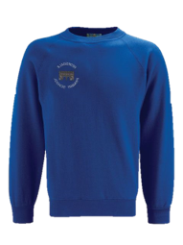
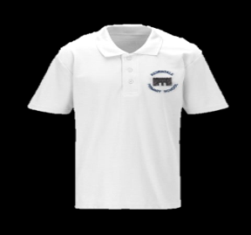
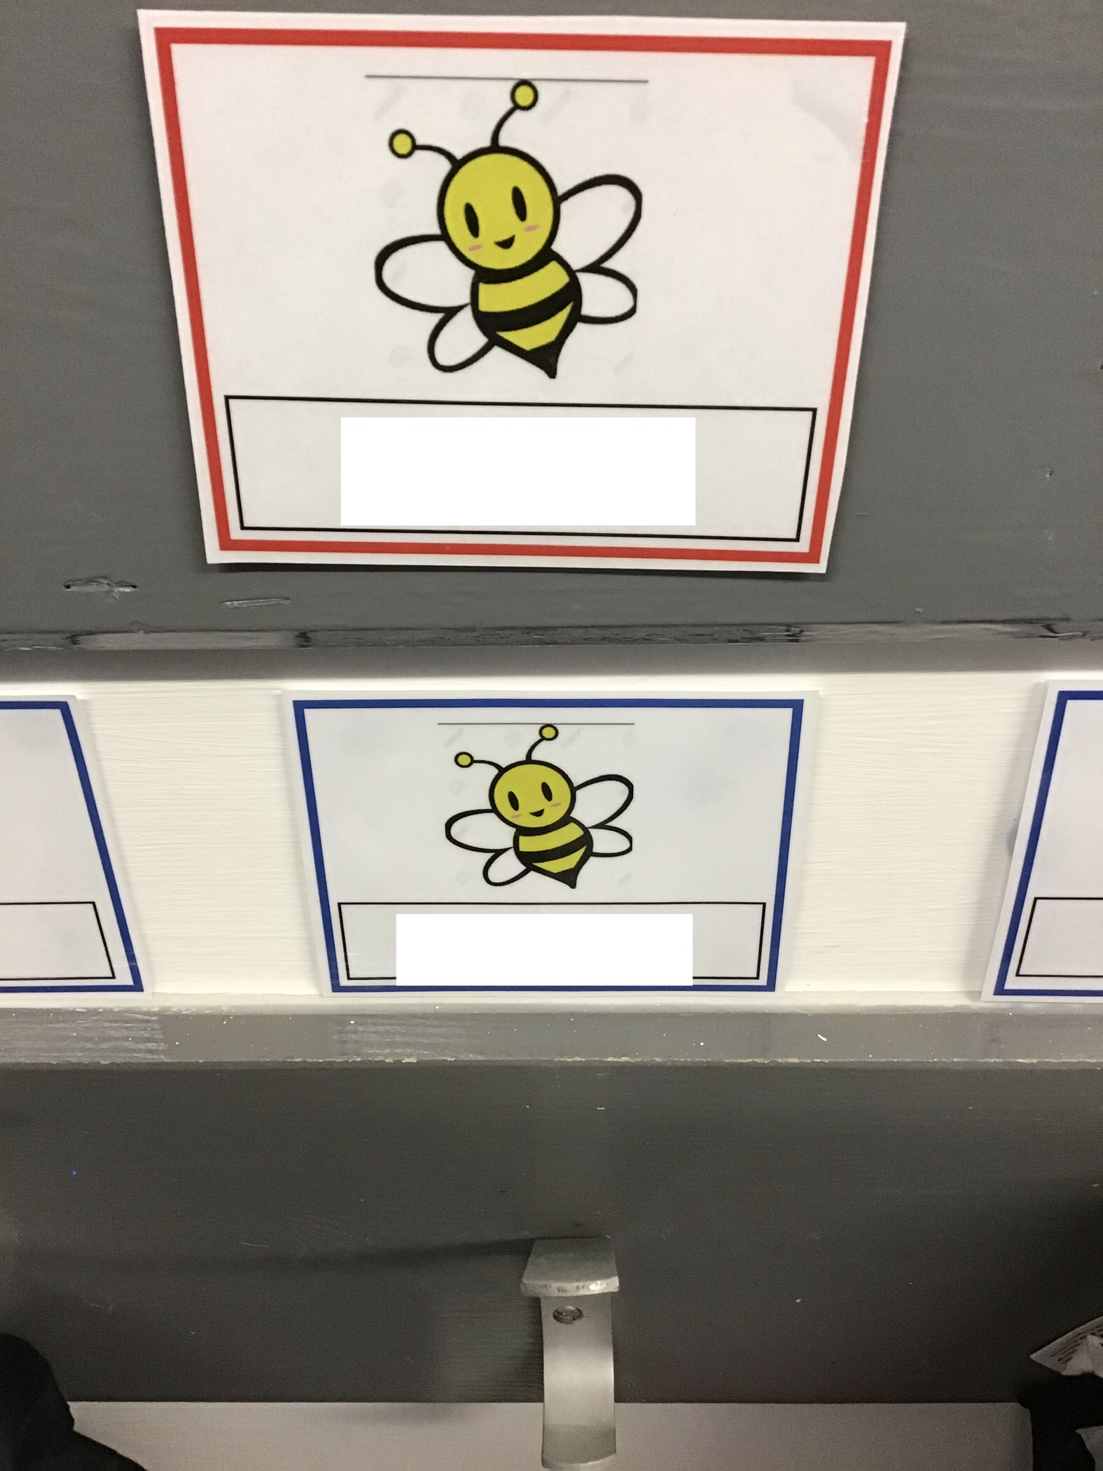
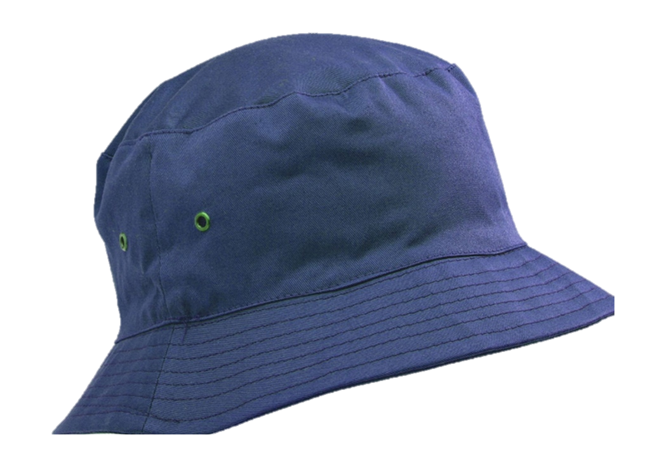
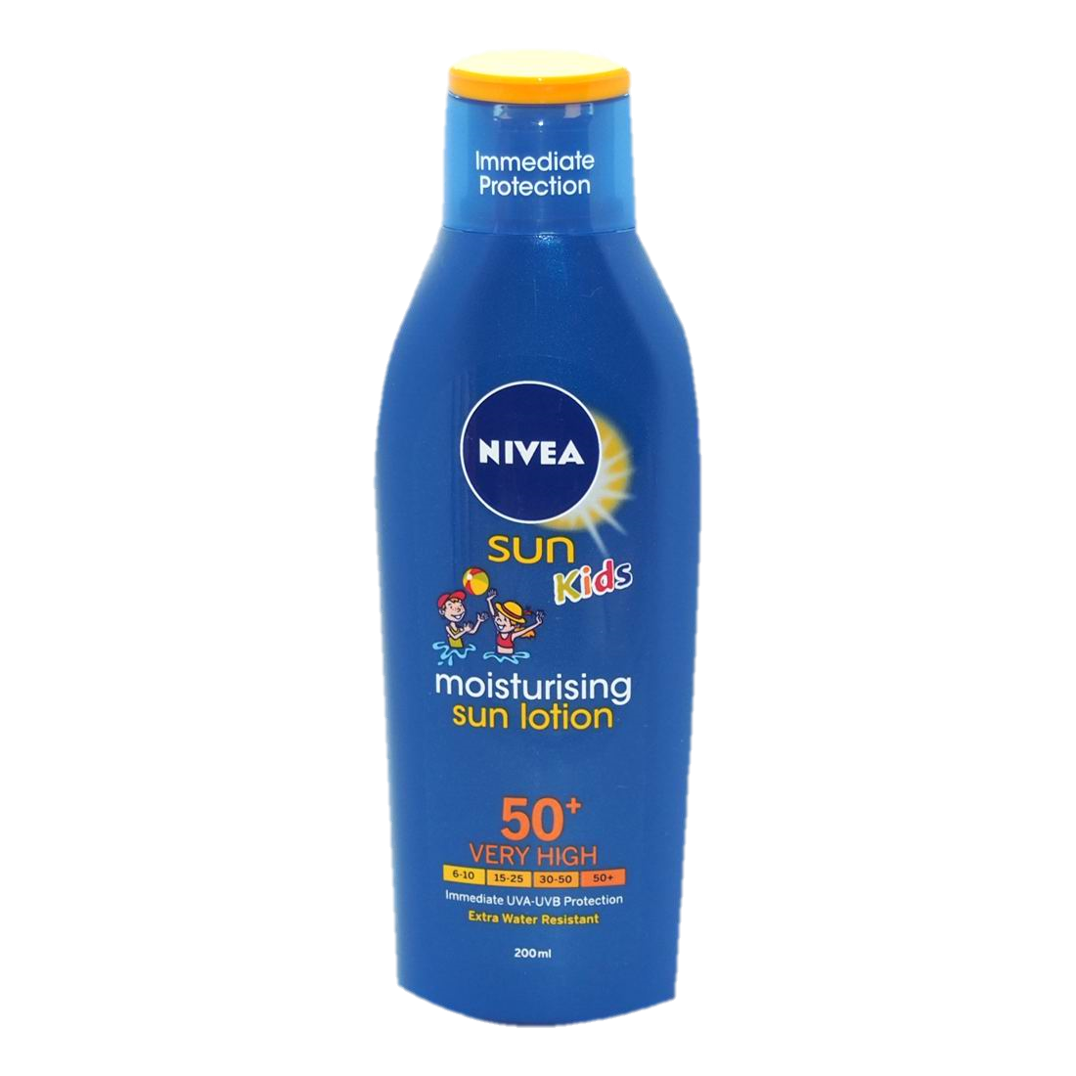
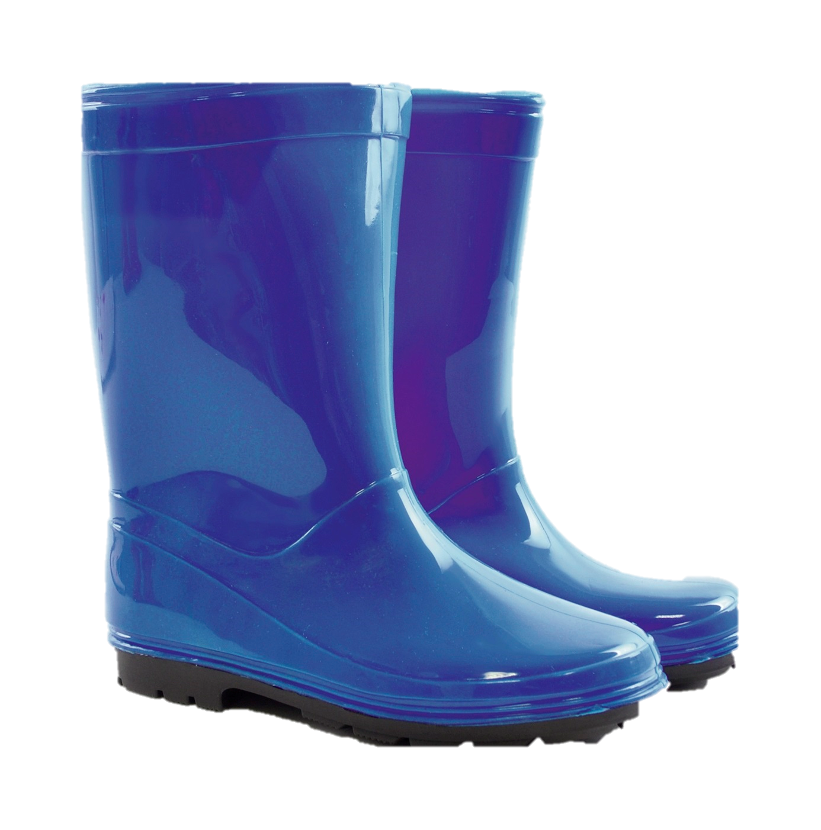
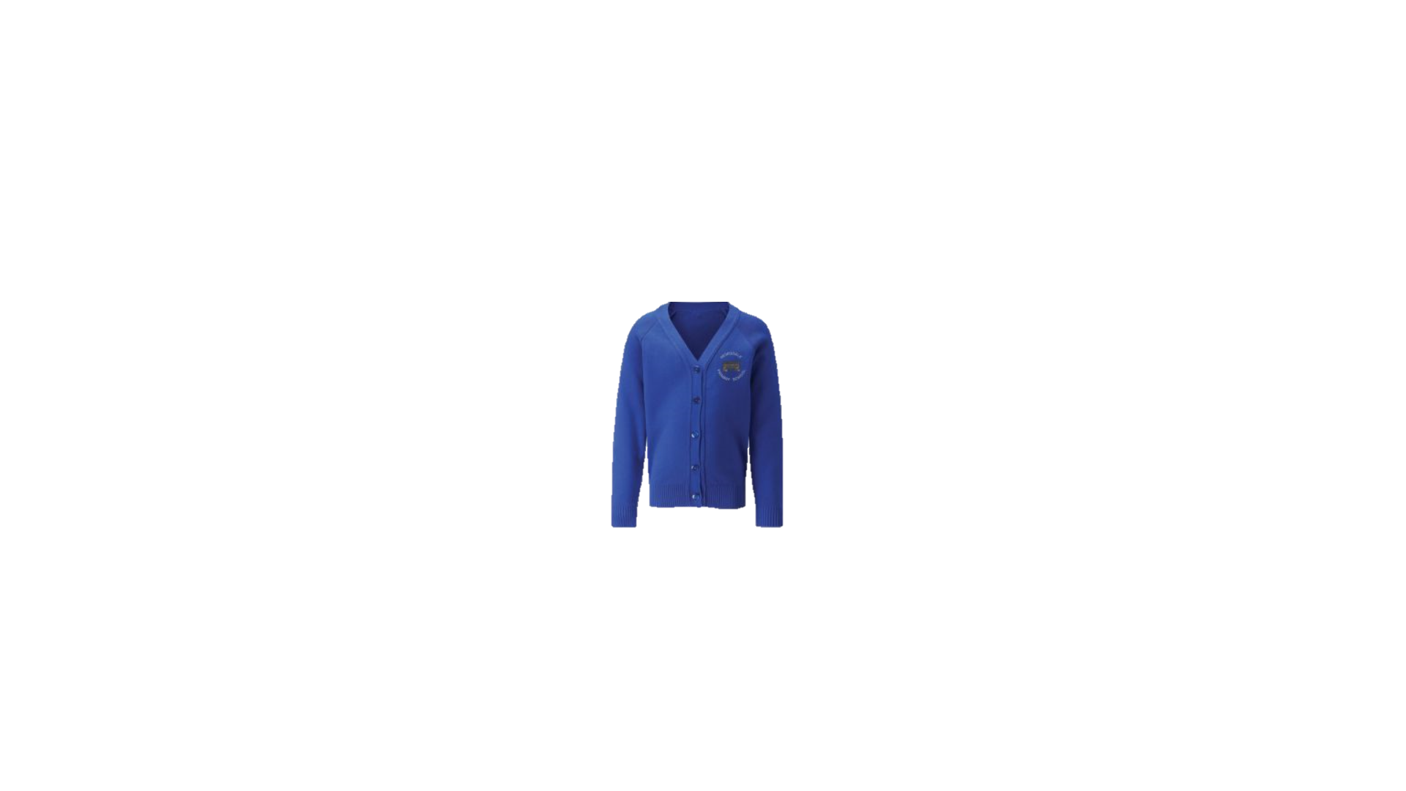
Organisation
Uniform is non- compulsory but is available to order from
www.emblematic.co.uk
if you wish to do so.
Children should wear a sunhat and sun cream in warm weather. Please apply cream before coming to school.
Every child will have their own peg with their name and a special picture.
Children can bring their own wellies in school.
Notes:
Come to school in PE kit – spare white soled trainers for PE

Slide 6
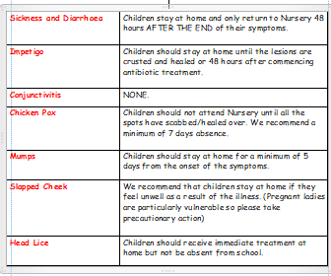
Attendance & Absence
Notes:
Come to school in PE kit – spare white soled trainers for PE

Slide 7
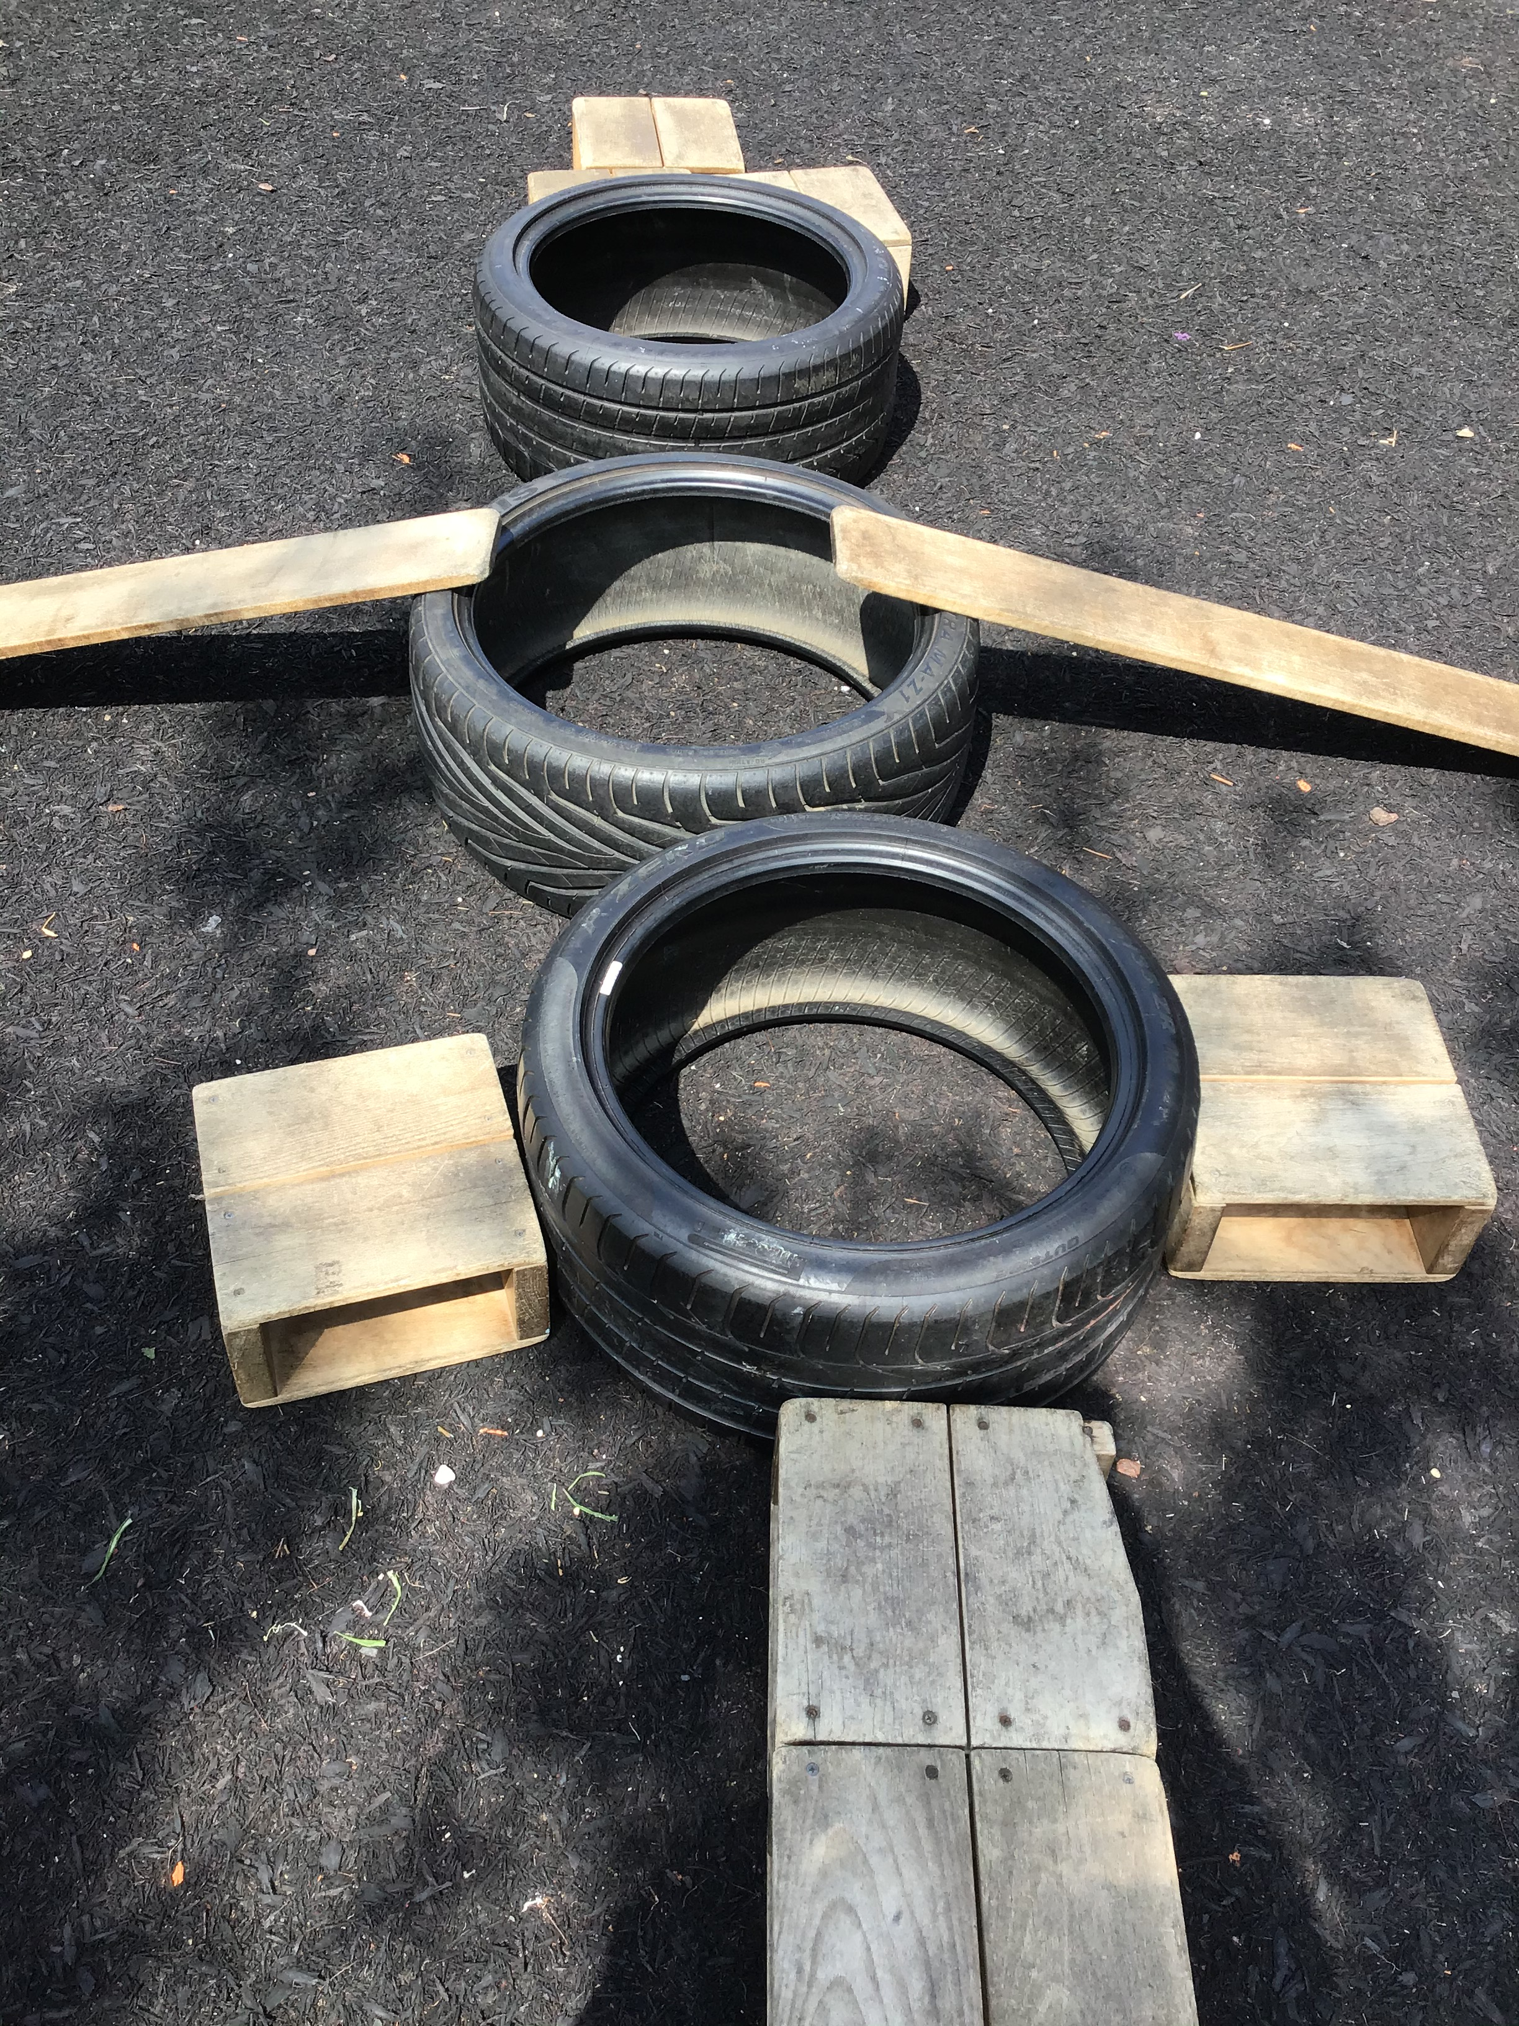
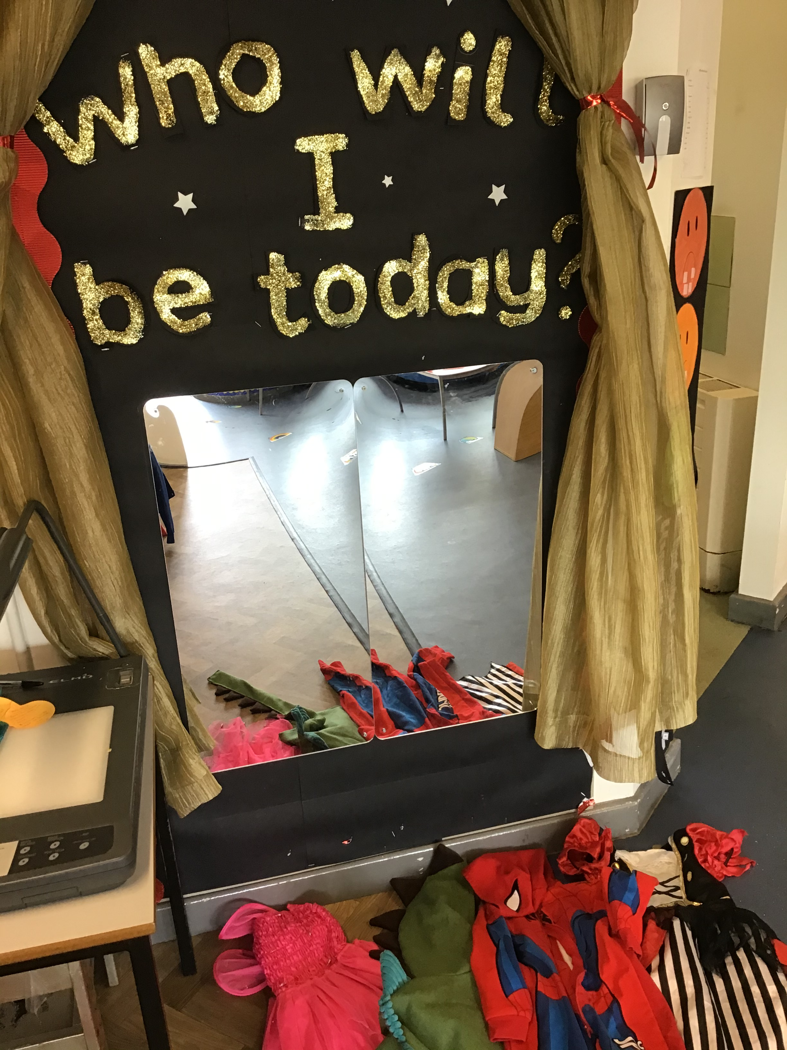
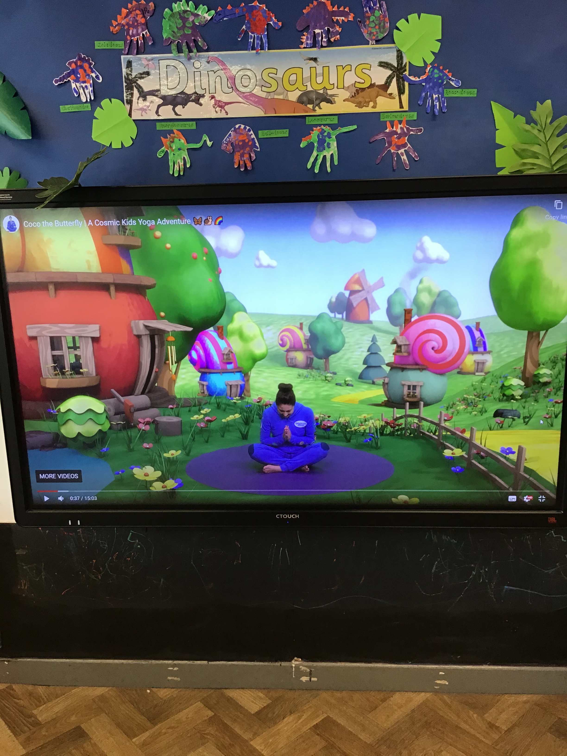
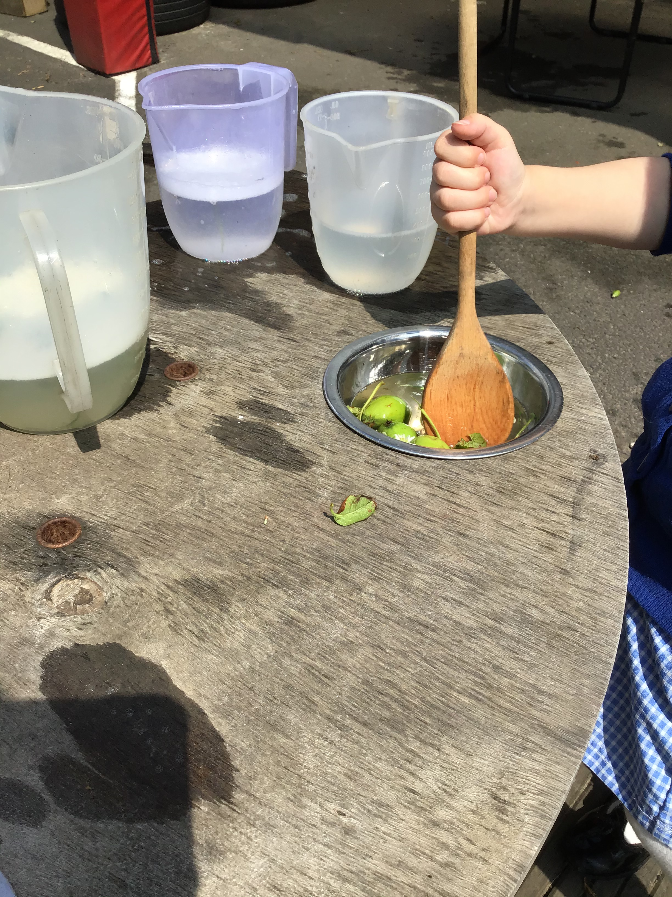
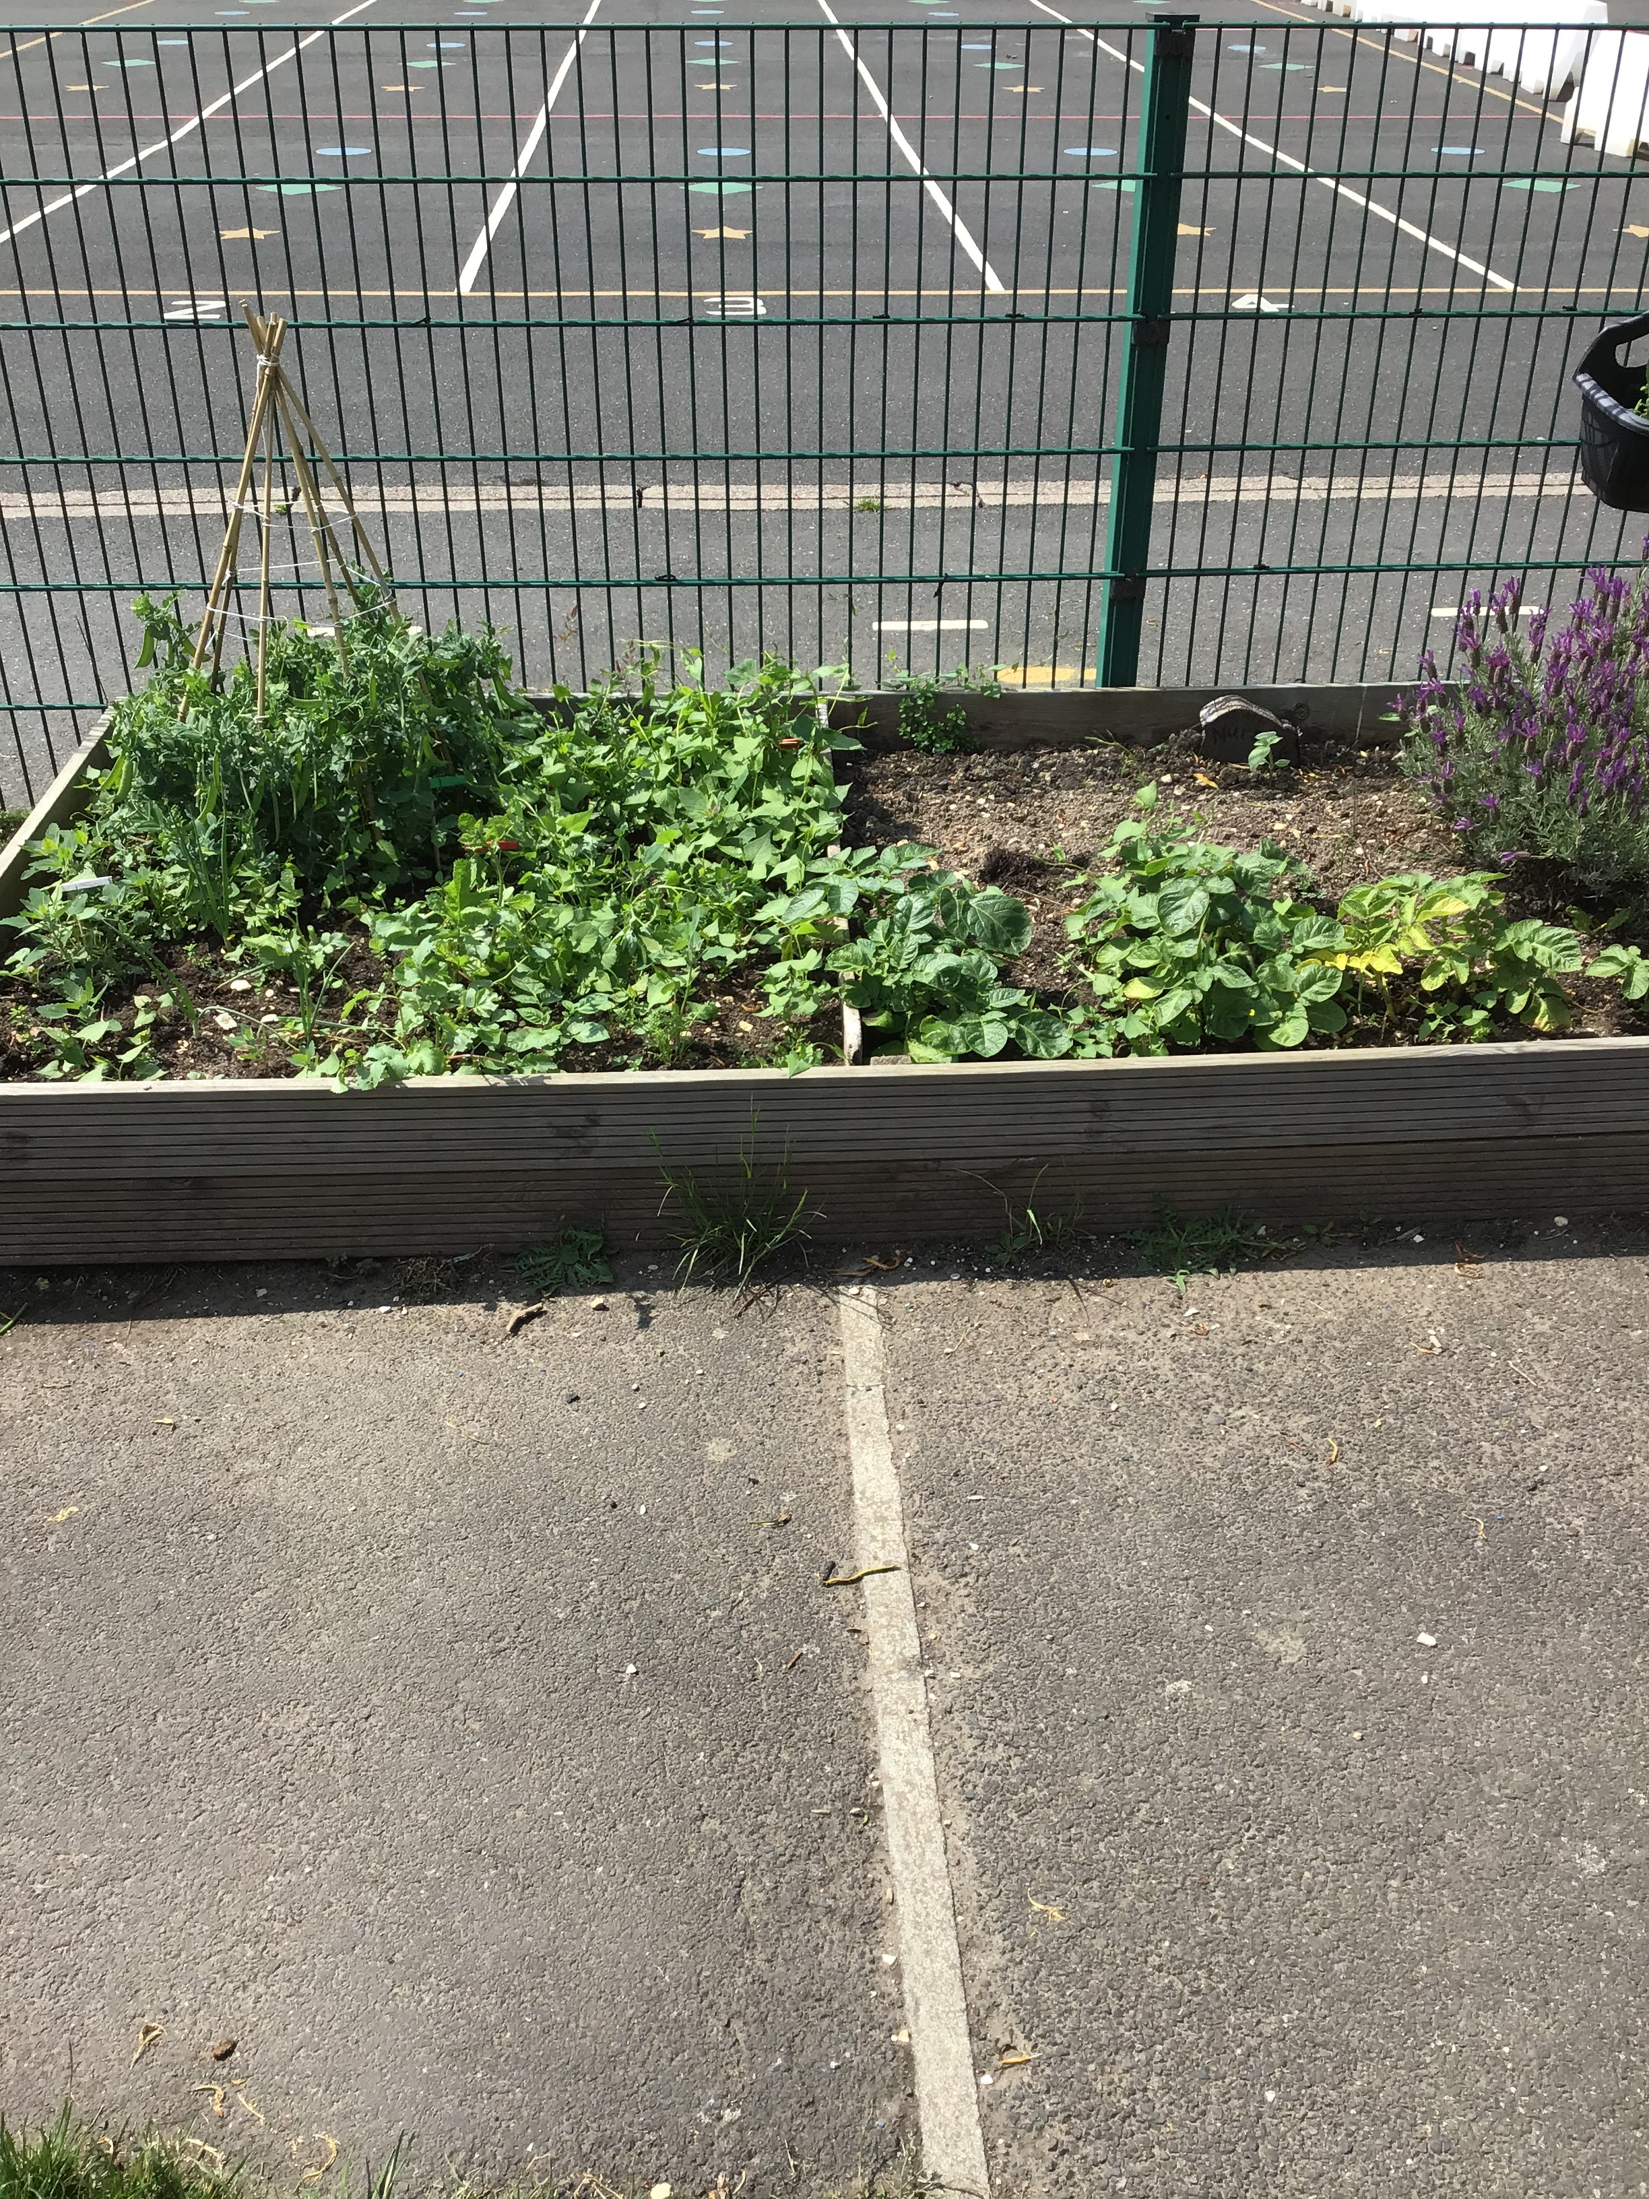
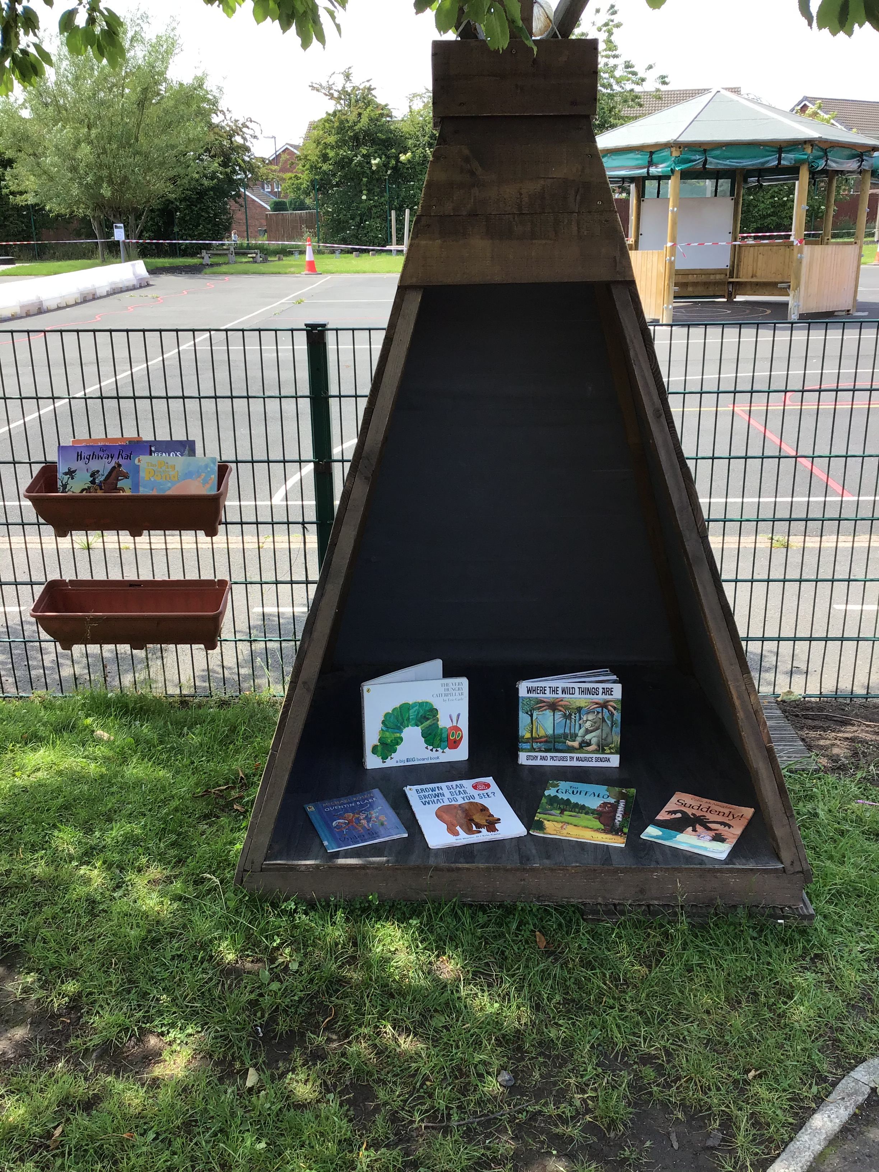
Settling in & Daily Routine
Sign up for free milk at www.coolmilk.com
Notes:
Come to school in PE kit – spare white soled trainers for PE

Slide 8

Curriculum

Slide 9
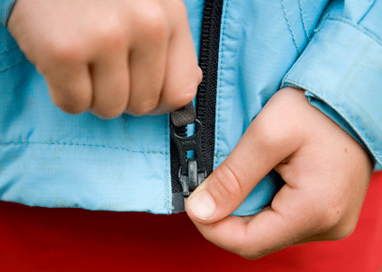
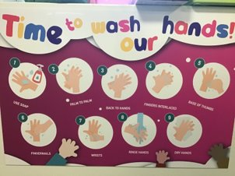
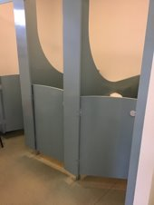
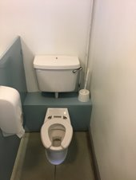
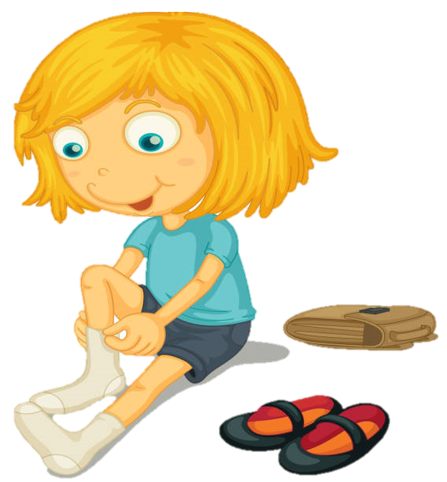
Independence

Slide 10
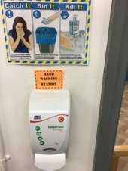
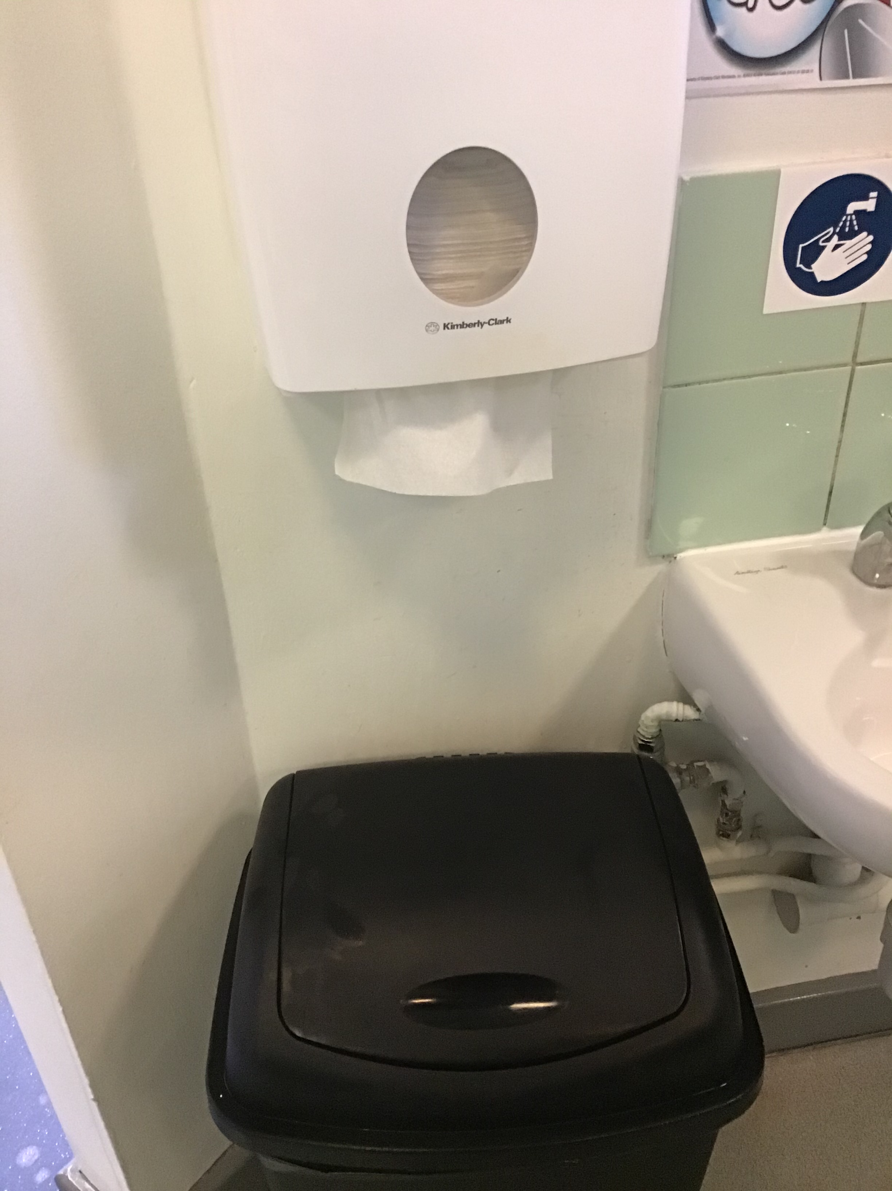
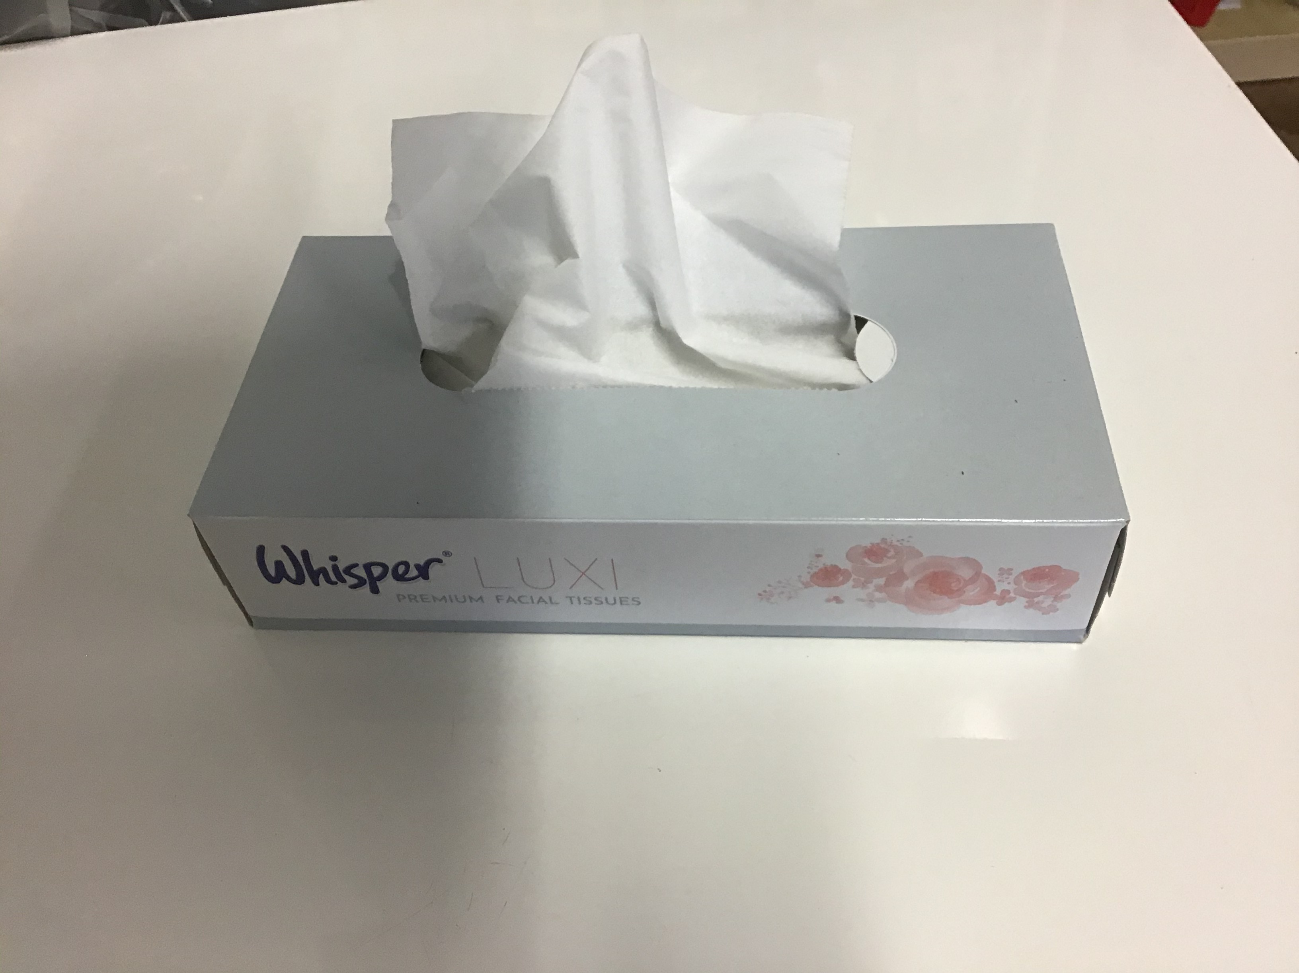
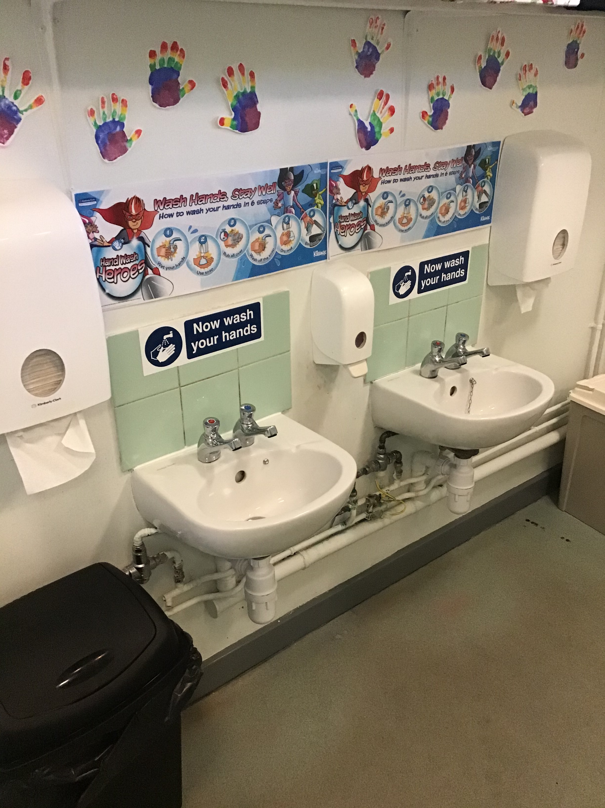
Hygiene
We wash them thoroughly for 20 seconds.
We supply tissues and children are encouraged to ‘Catch it. Bin it. Kill it. Or sneeze into their arm.
First we sanitise our hands.
Then we wash them with soap
We dry them using a paper towel.
Notes:
Phase bubbles

Slide 11
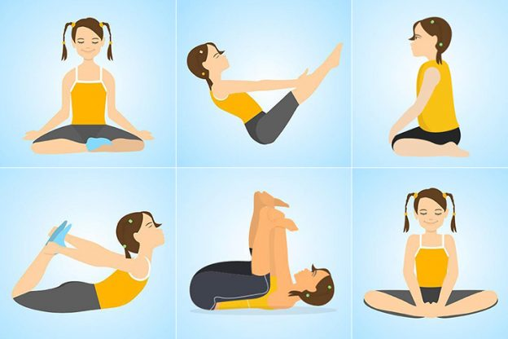

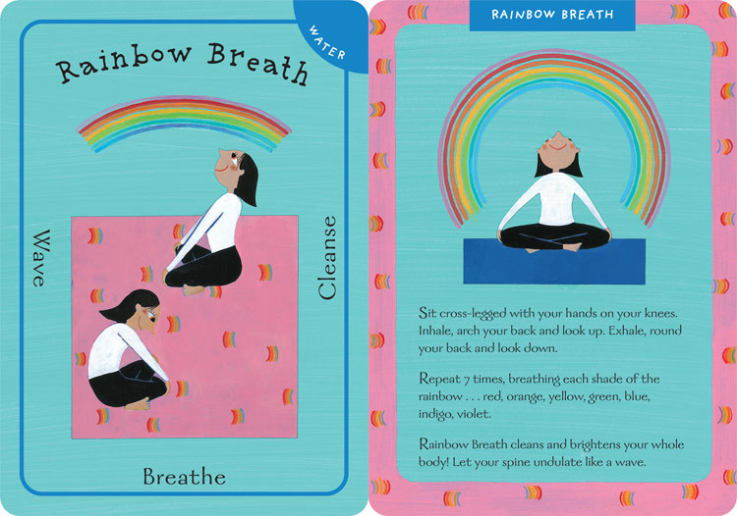

Mental Health
& Well Being
Yoga
Circle Time
Rainbow breaths
Blow the bubbles away!

Slide 12
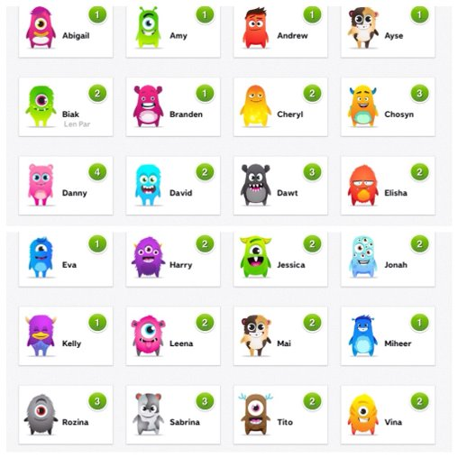
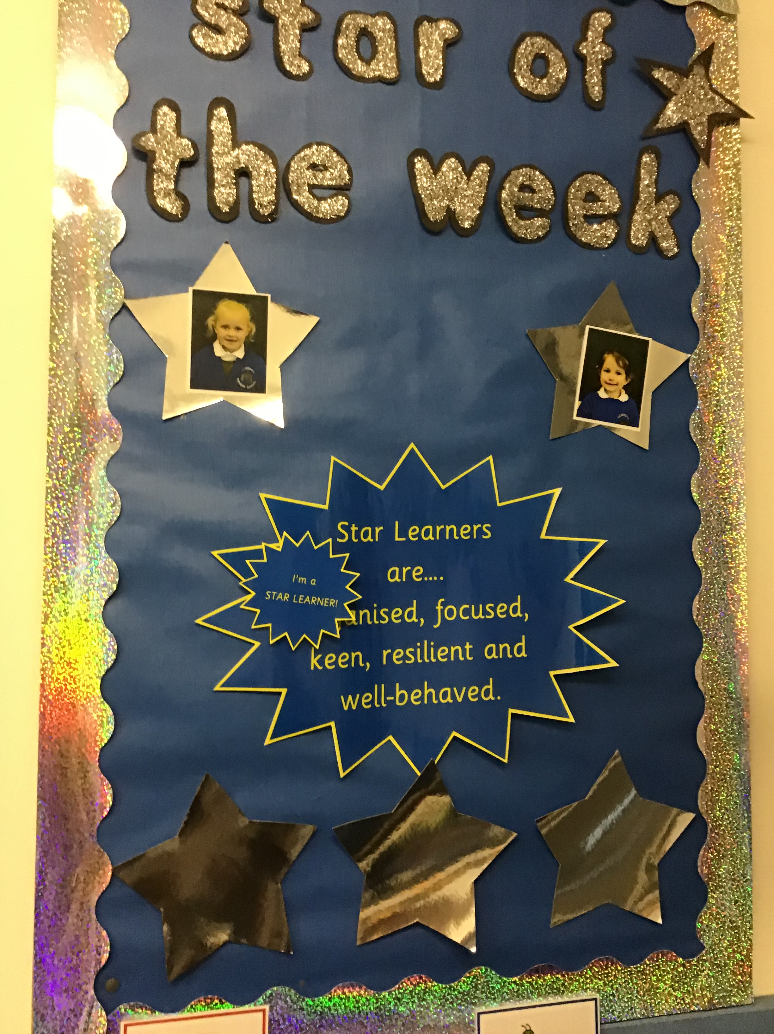

Expectations & Behaviour

Slide 13
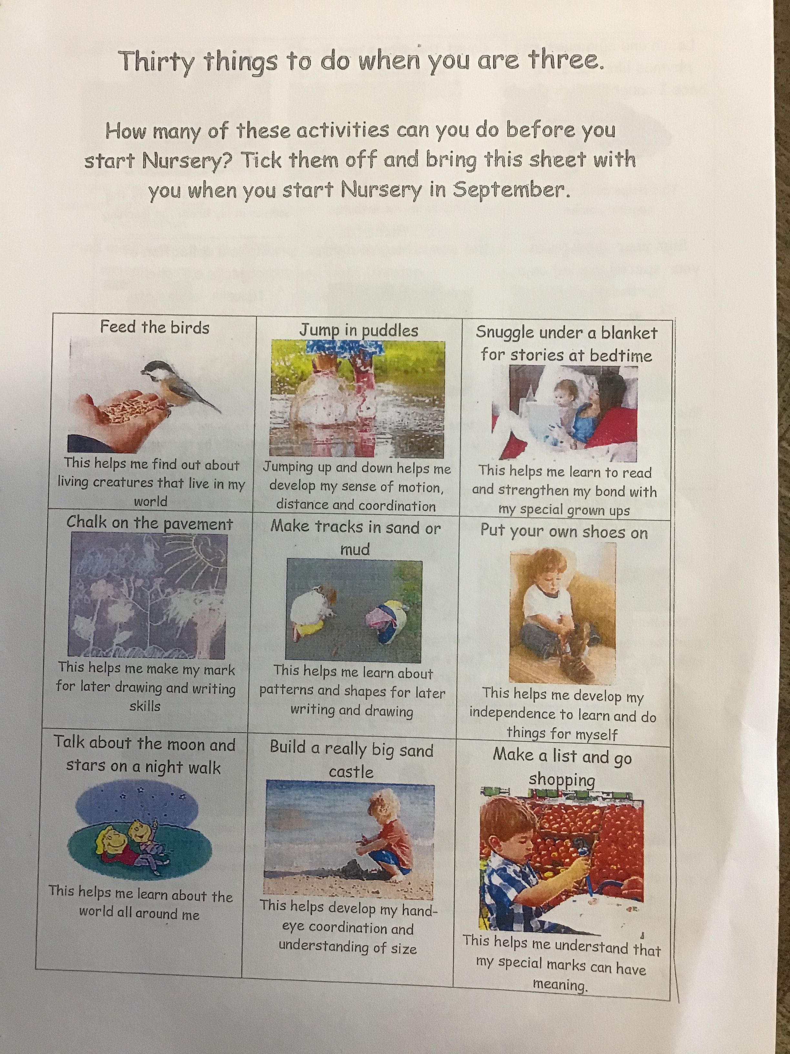
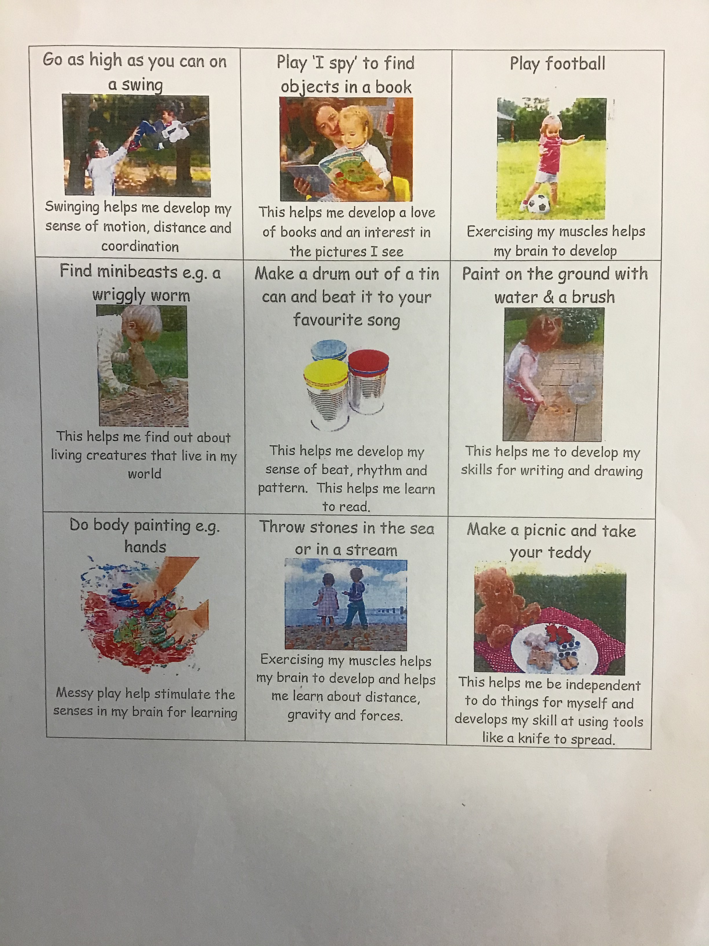
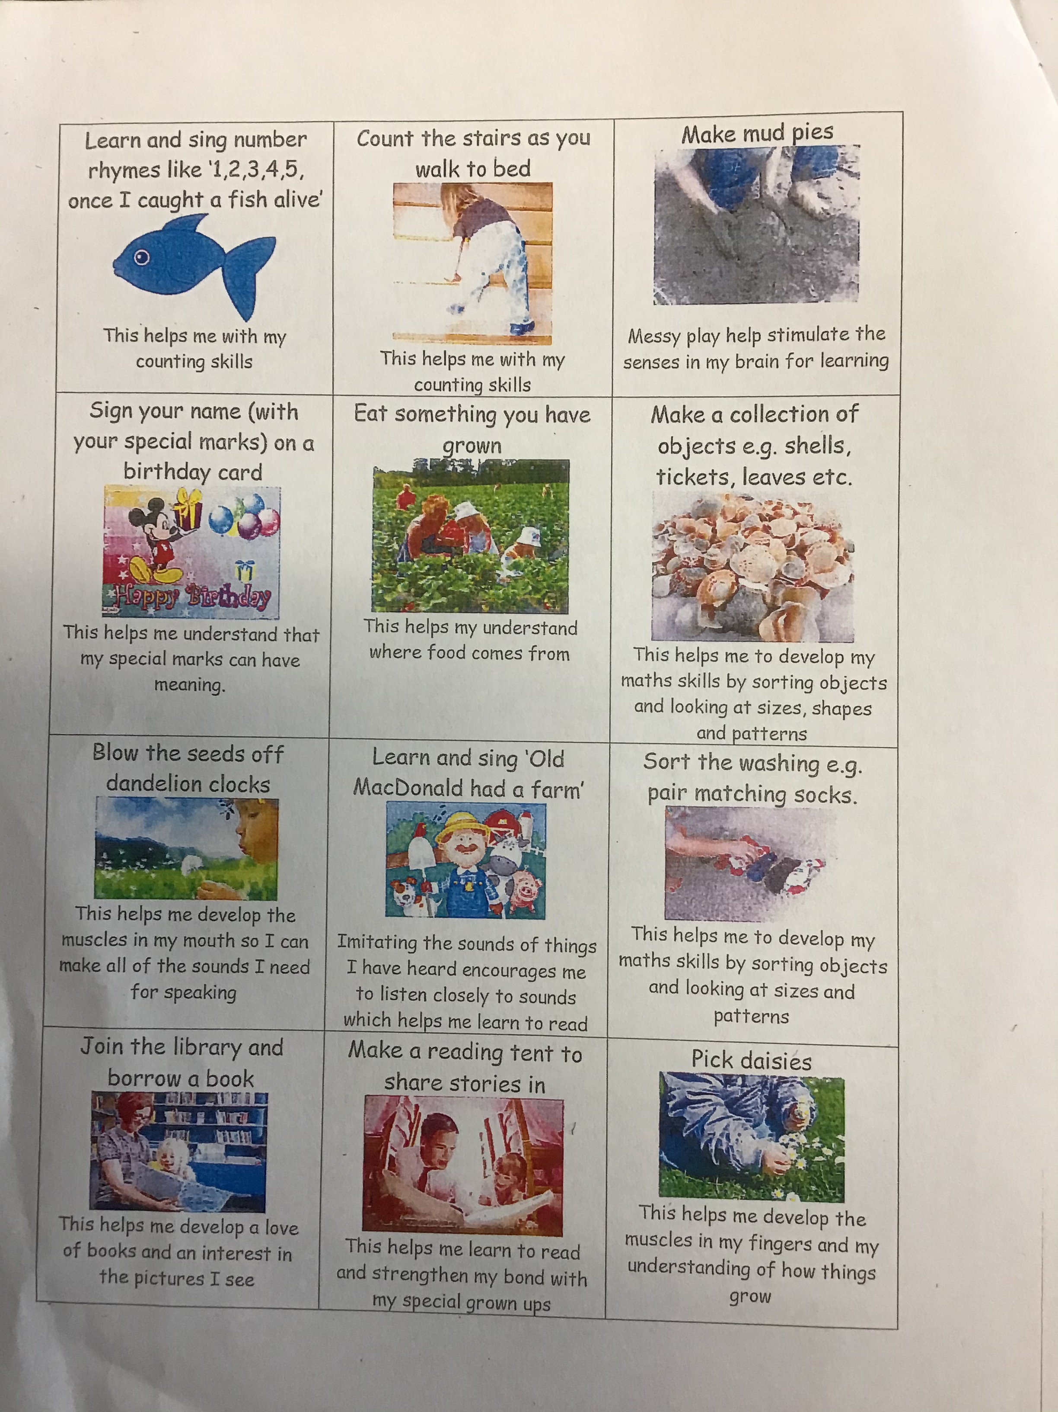
Over the Summer
Here are 30 things to do before the age of 3. How many can you do before coming to Nursery?
Notes:
Come to school in PE kit – spare white soled trainers for PE

Slide 14
Final Word
Please note that the information provided in this presentation may be subject to change over the Summer Holidays due to Department for Education (DfE) Guidance. We ask you for your patience and understanding as we work to meet the needs of the children using the most up-to-date information.
Should we need to inform you of any changes prior to September, we will contact you using our usual channels of communication - Class Dojo and Parent Mail.
Notes:
Come to school in PE kit – spare white soled trainers for PE

