Slide 1



Reception September 2021
September 2020

Slide 2

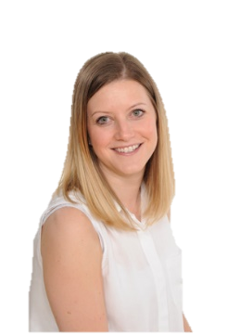
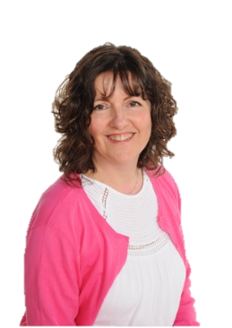
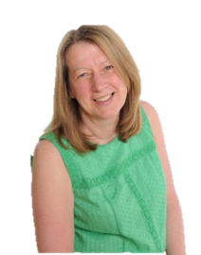
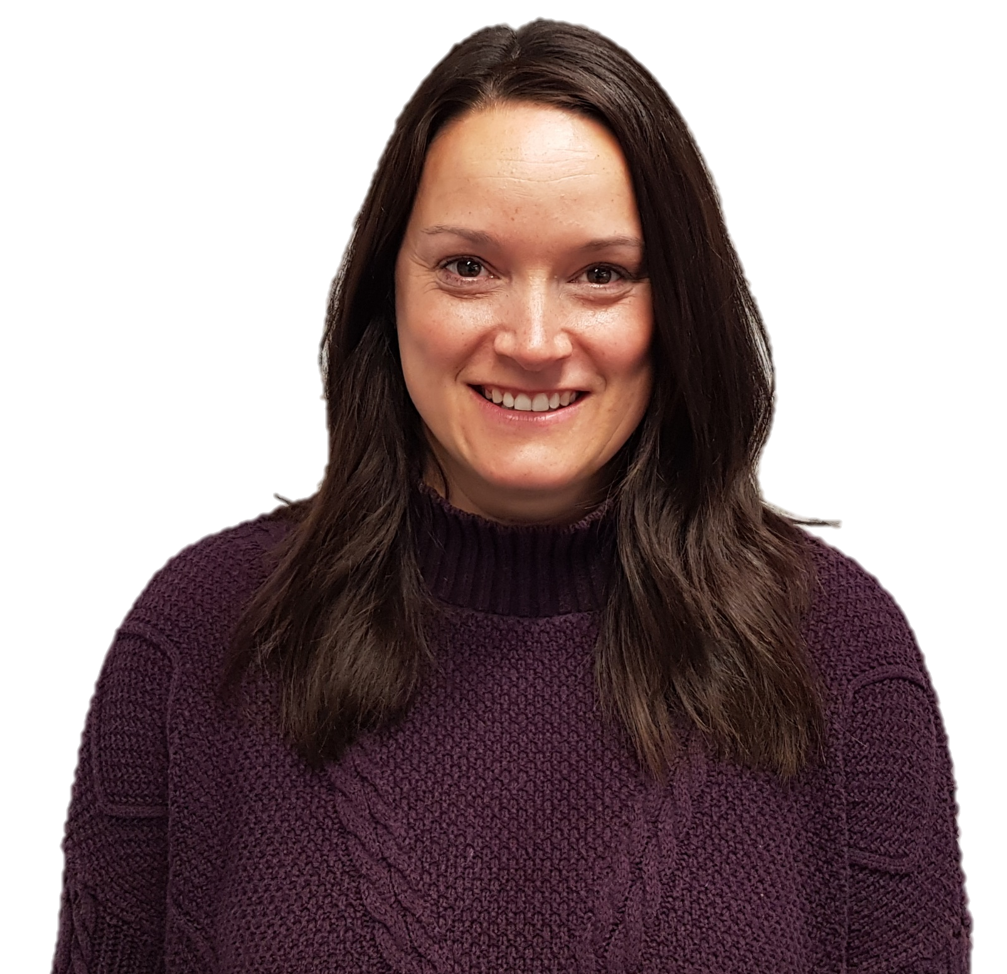
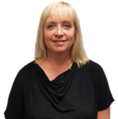
Meet The Staff
Miss Heaton
Class Teacher
Mrs Johnson
Class Teacher
Mrs White
Teaching Assistant
Mrs Reid
Teaching Assistant
Miss Armstrong
Class Teacher & Assistant Head

Slide 3
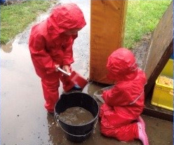
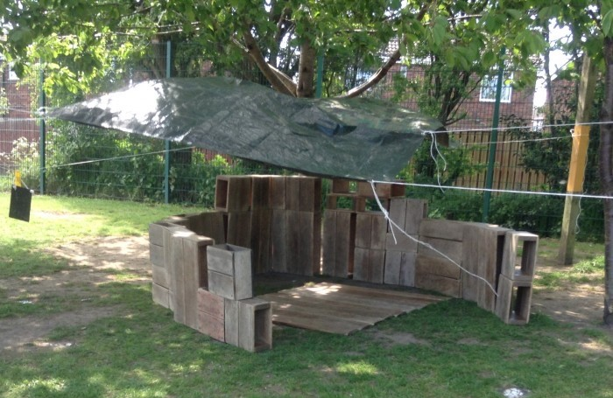
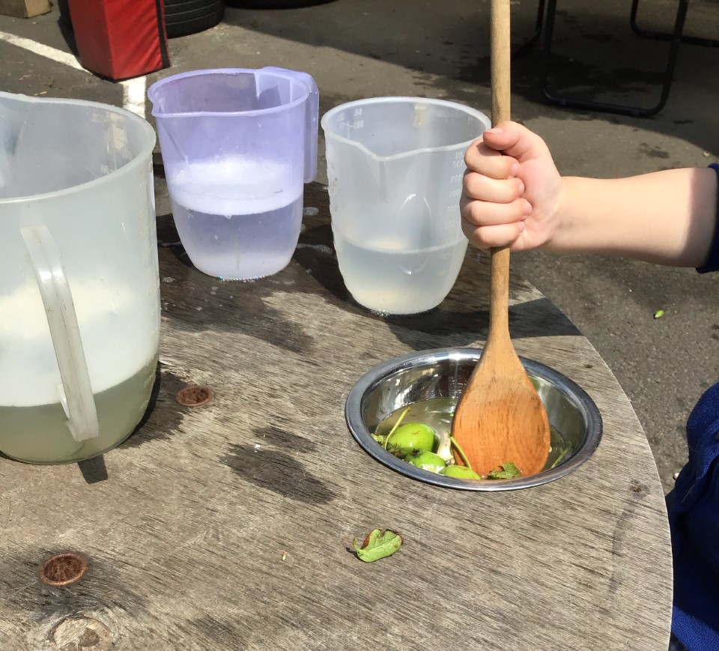
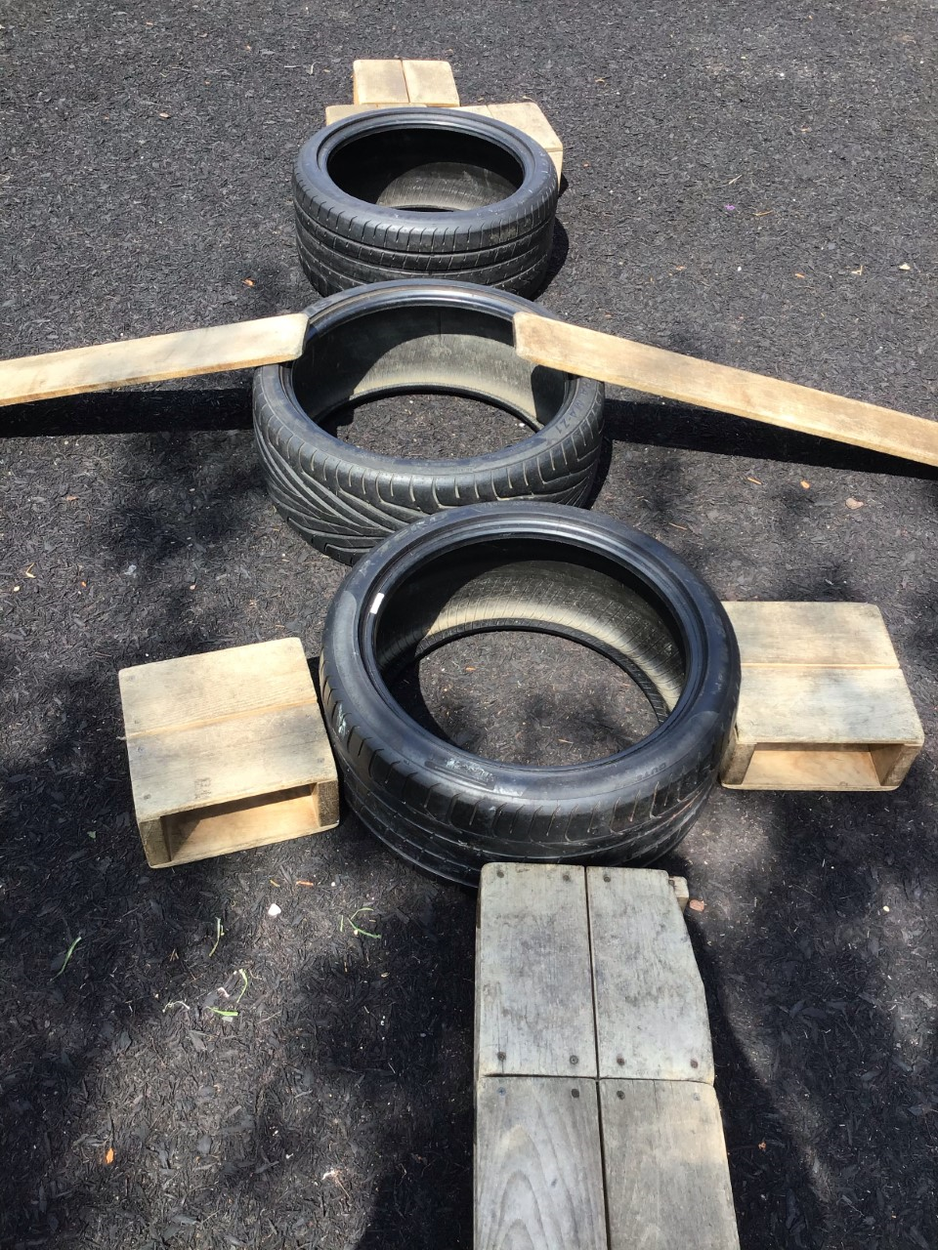
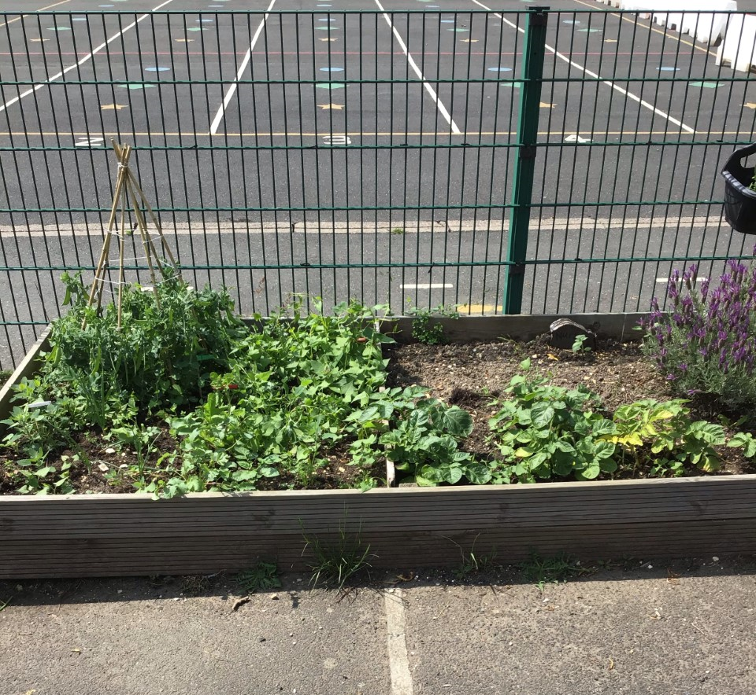
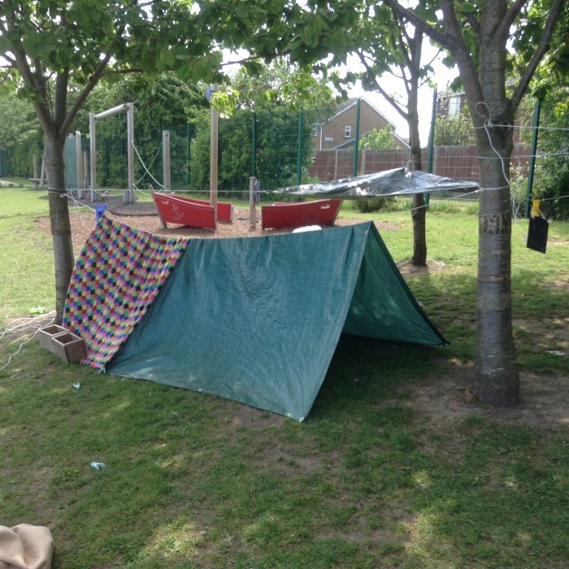
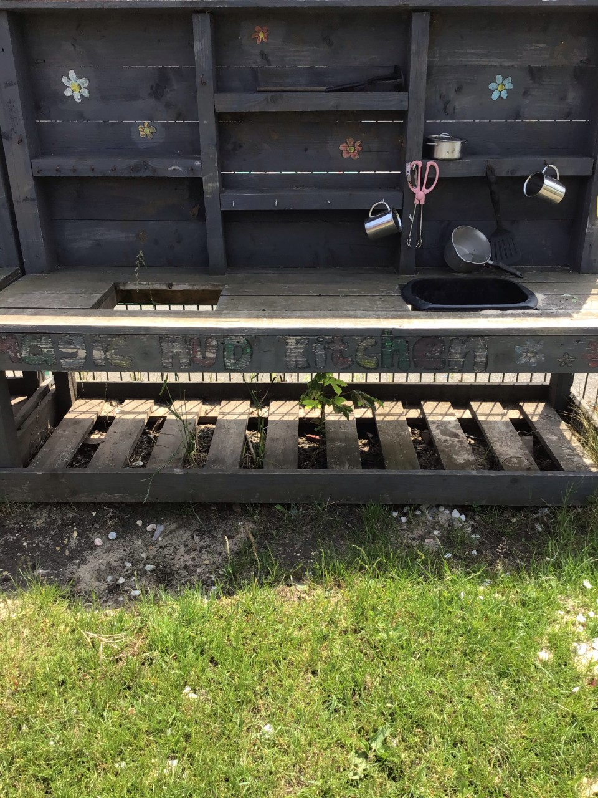
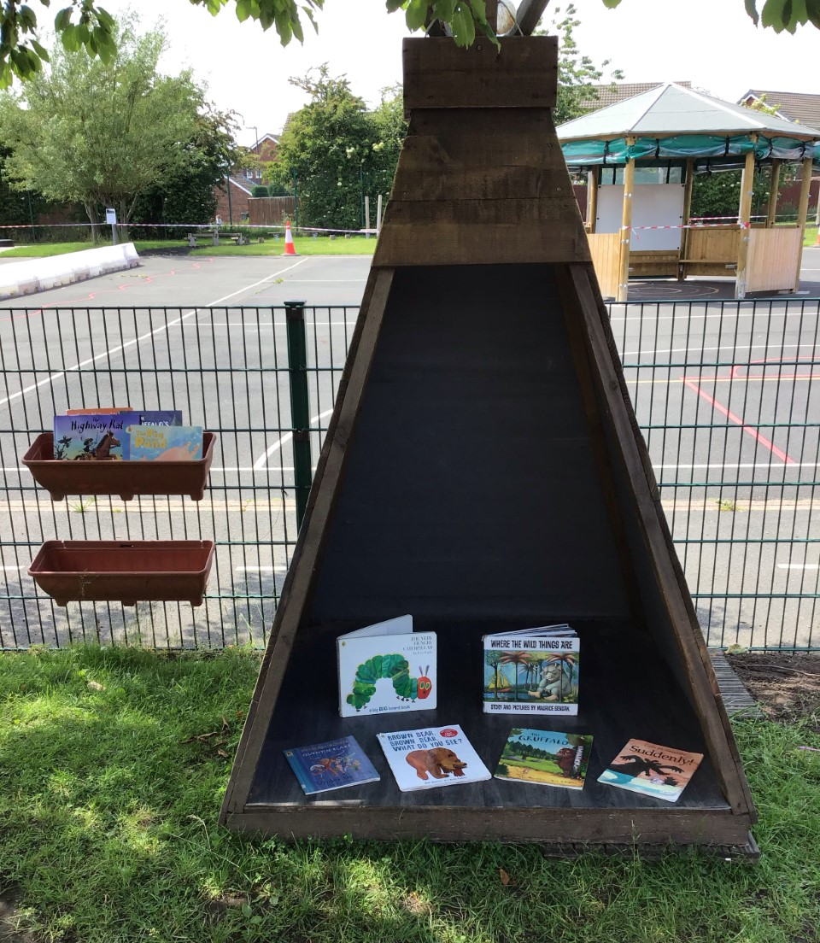
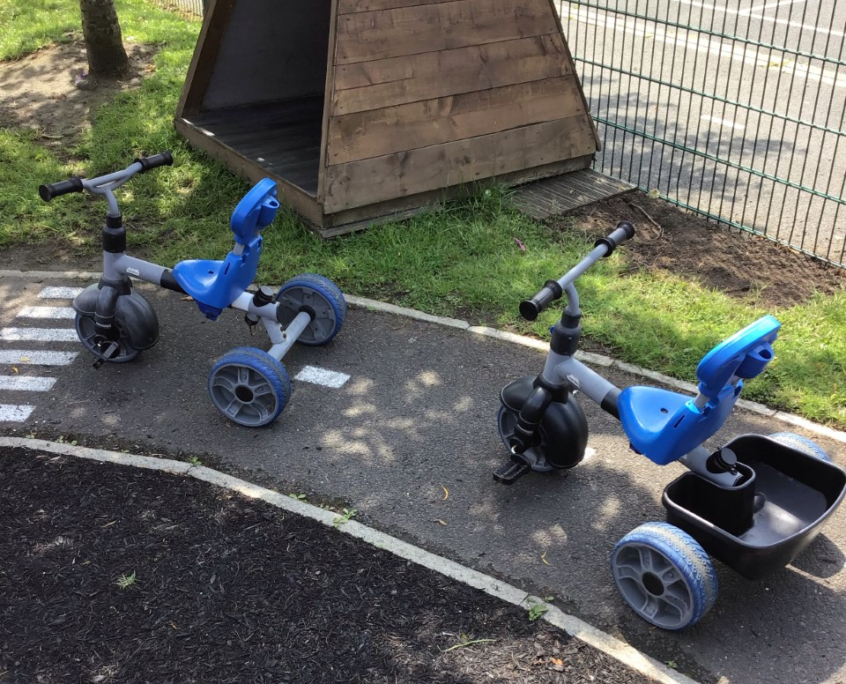
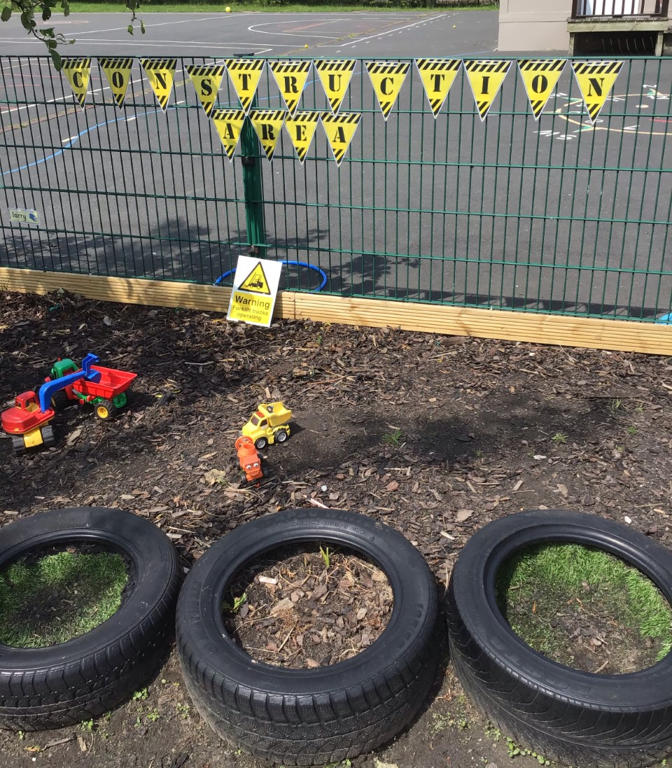
Reception

Slide 4
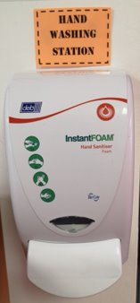

Hygiene
Notes:
Phase bubbles

Slide 5
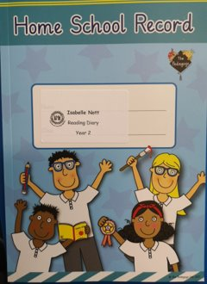
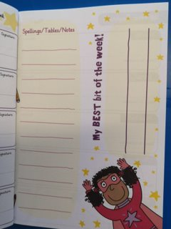
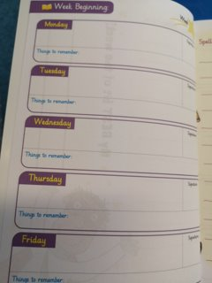

Expectations
& Behaviour
We are PROUD to be at Redesdale Primary School and have 5 key rules.​
Polite ​
Respect​
Open and honest​
Understanding​
Do our best​
Children are rewarded for positive behaviour through our Class Dojo school system.

Slide 6
Start
&
Finish Times
CLASS | START TIME | FINISH TIME
Reception | 8.55am Playground | 3.15pm Playground
Notes:
Social distancing, arrive at allotted times, one parent only, explain footprints, one way system, playtimes – allocated part of the yard/field, parents not on school site-contact by phone or dojo

Slide 7


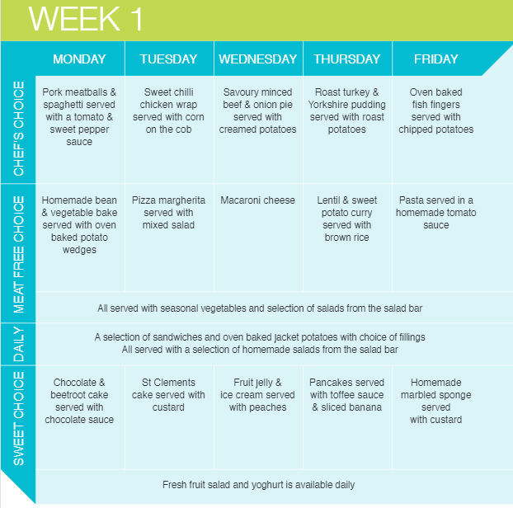
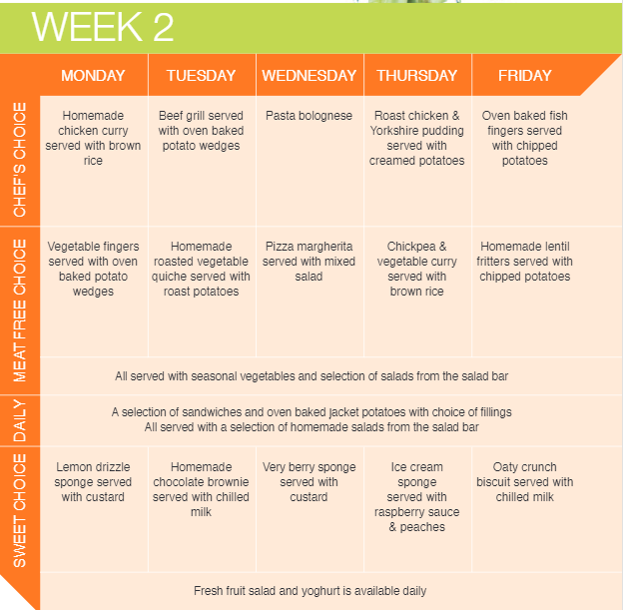
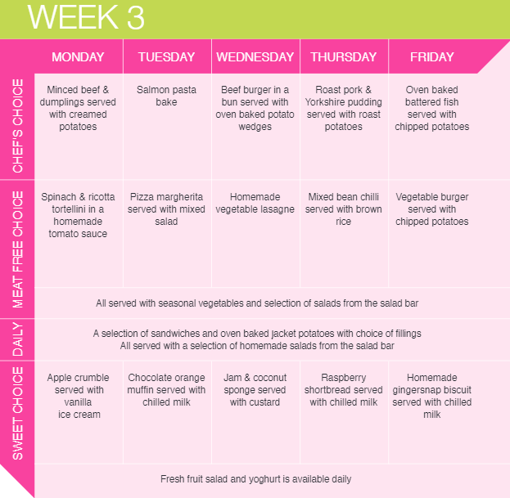
Lunchtimes
There is a new Hot Meal Menu. It will run on a 3 week cycle.

Slide 8
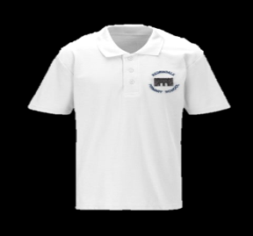
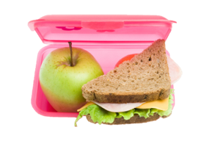

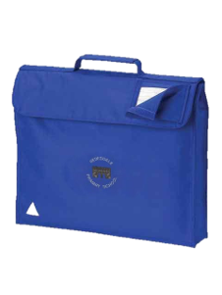

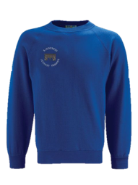
* Fruit & milk
* Water bottles
* Names in belongings
Notes:
No backpacks or toys

Slide 9
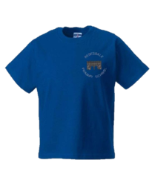
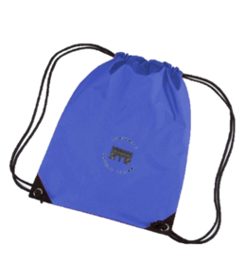
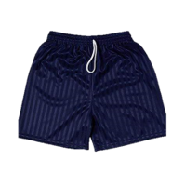
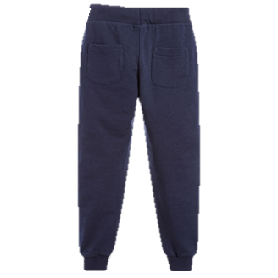

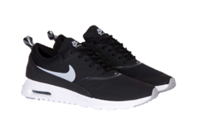
PE
Come to school in PE kit on your PE day
Wear dark blue shorts and navy blue, plain tracksuit bottoms.
Trainers with non-marking soles to be worn for PE (PE will be take place outdoors as much as possible)
Notes:
Come to school in PE kit – spare white soled trainers for PE

Slide 10
Class Dojo
Class Dojo codes will be sent home with children in September. The code enables you to connect to the class and receive updates from the class teacher.
If parents wish to contact a member of school staff, this must be done via Class Dojo or Telephone.

Slide 11
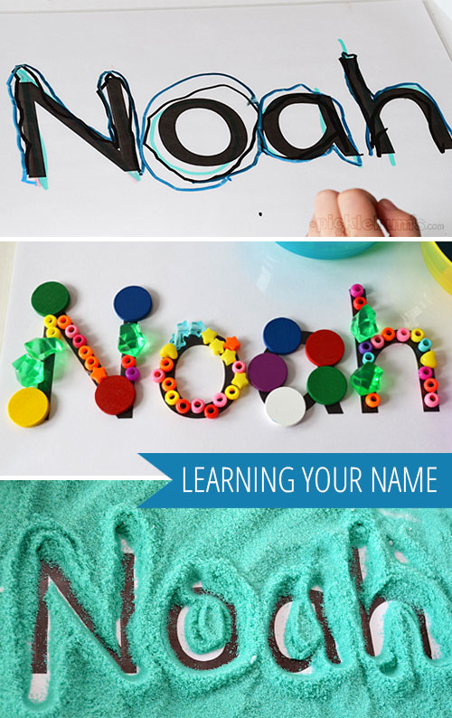



Home Learning

Slide 12
Please note that the information provided in this presentation may be subject to change over the Summer Holidays due to Department for Education (DfE) Guidance. We ask you for your patience and understanding as we work to meet the needs of the children using the most up-to-date information.
Should we need to inform you of any changes prior to September, we will contact you using our usual channels of communication - Class Dojo and Parent Mail.

