Slide 1



Lower Key Stage 2
Y3 & 4
September 2021
September 2020

Slide 2


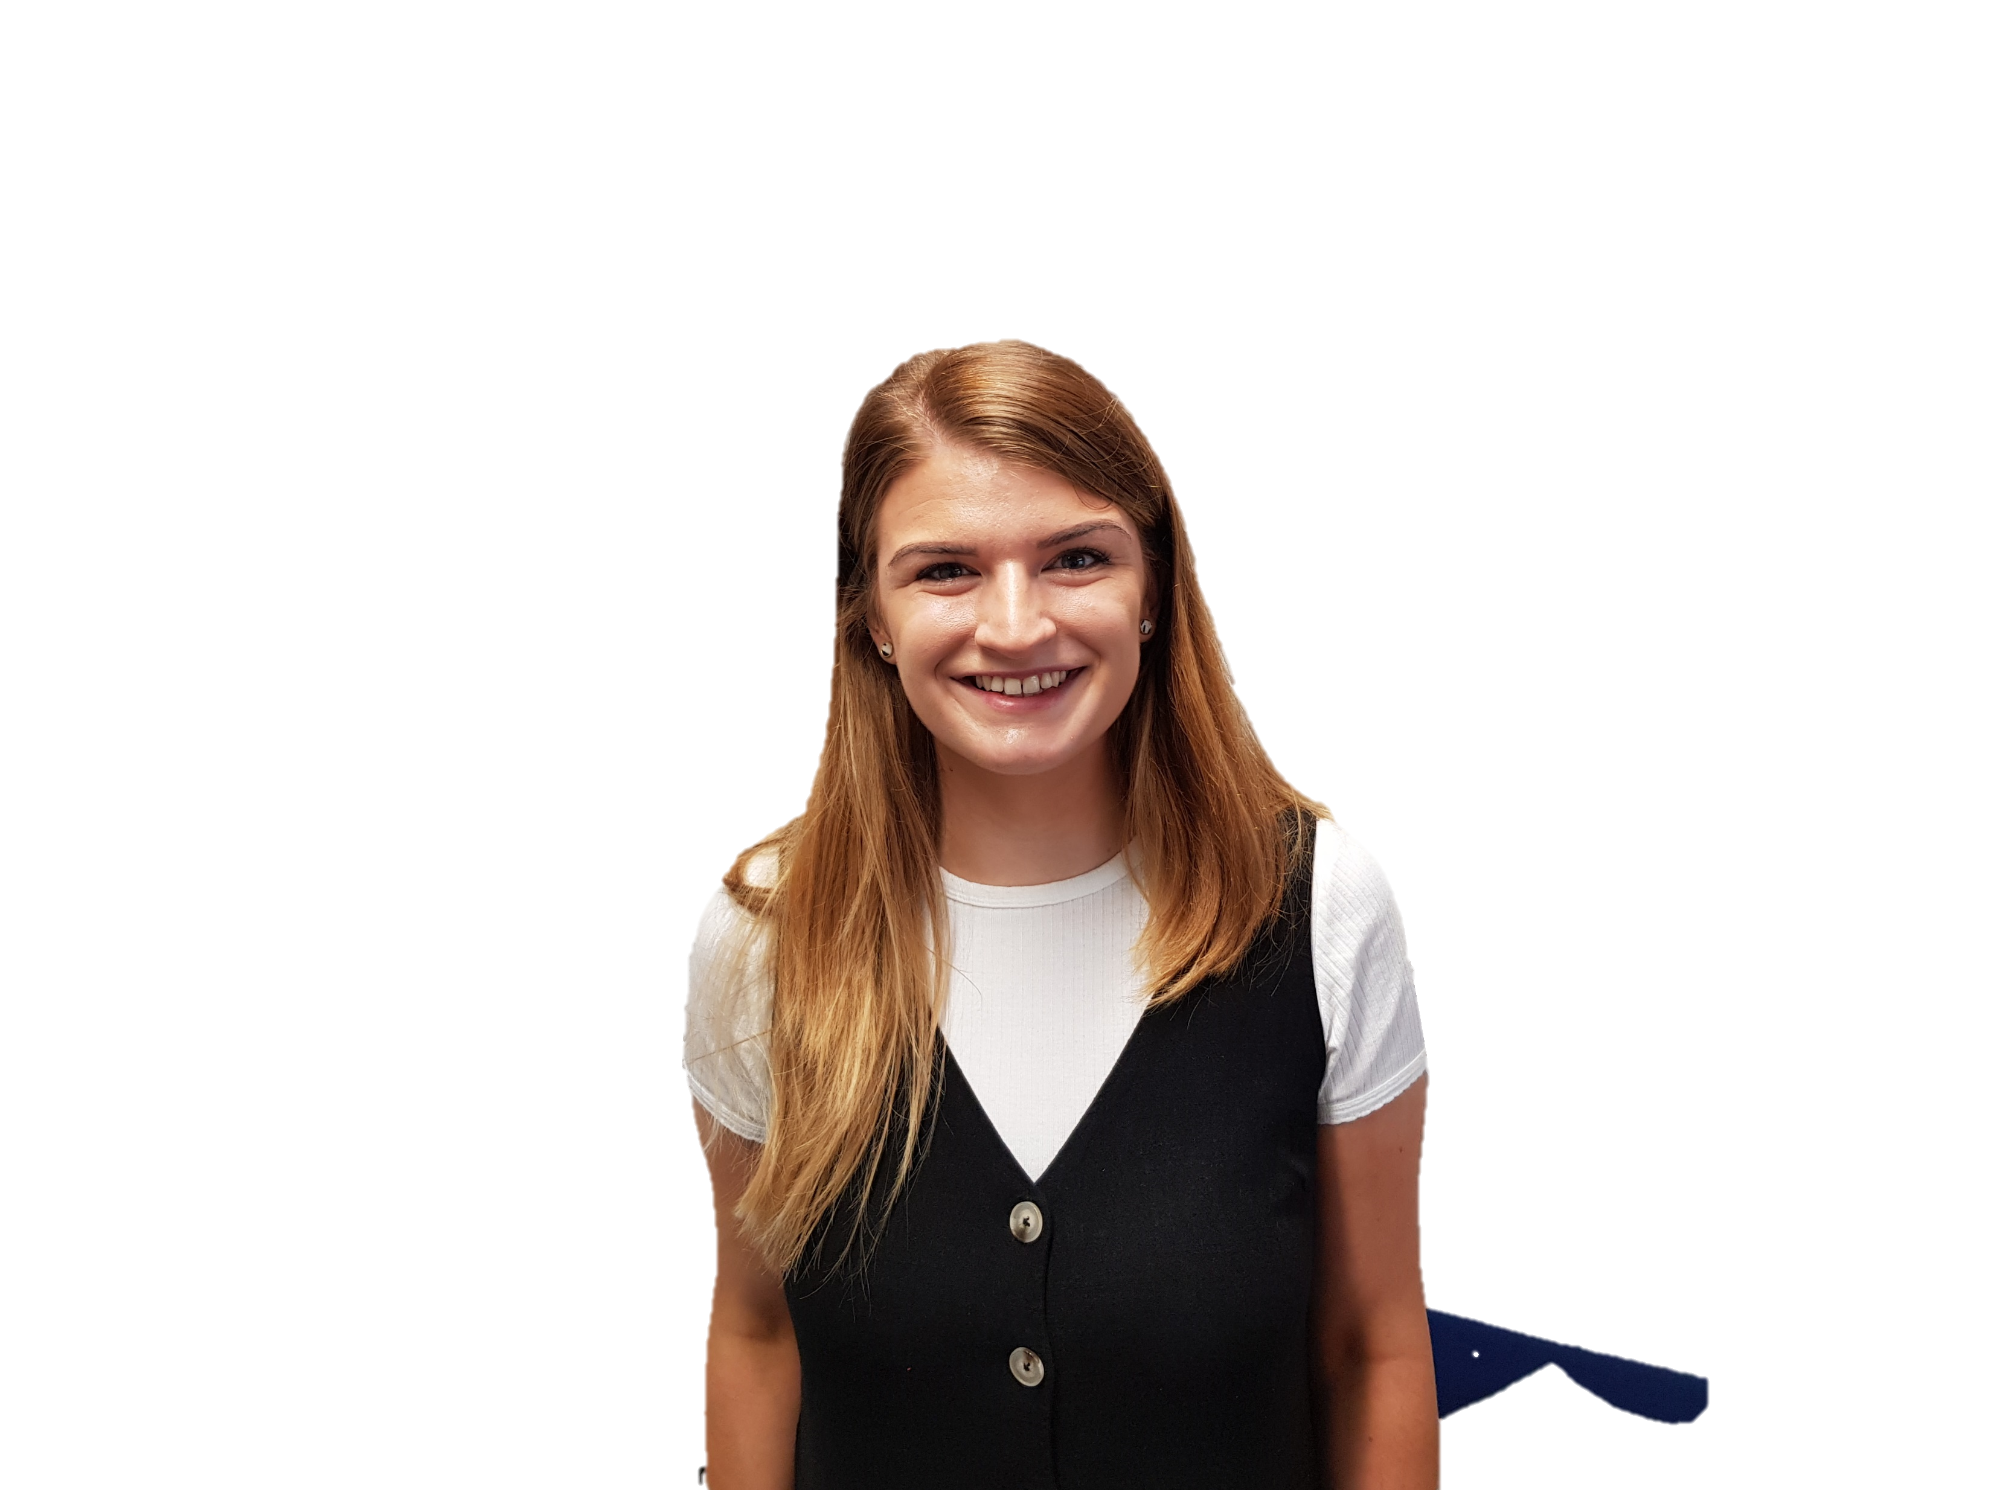
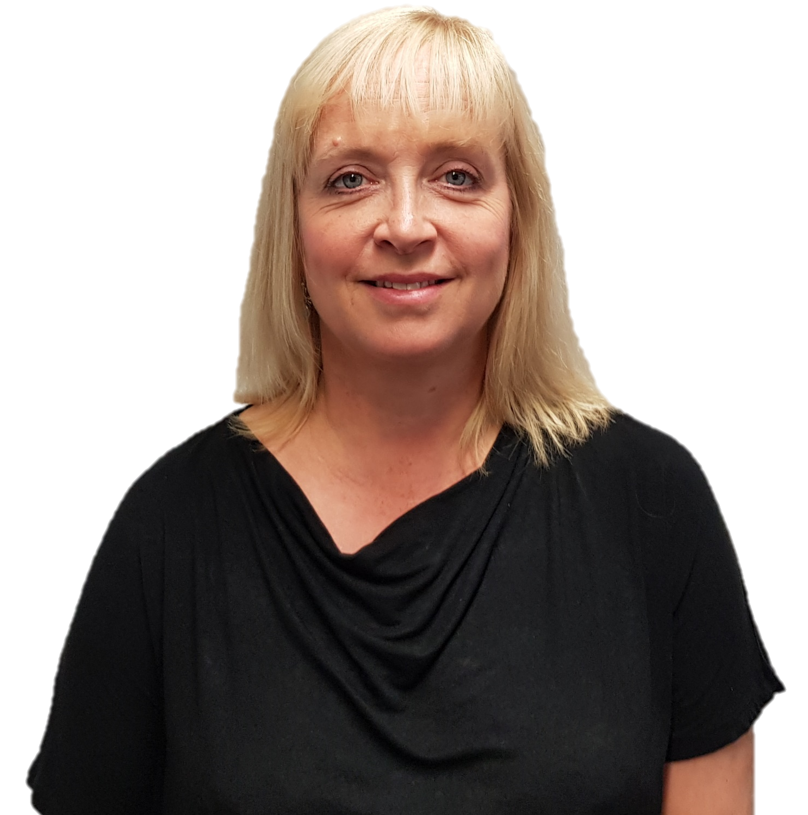

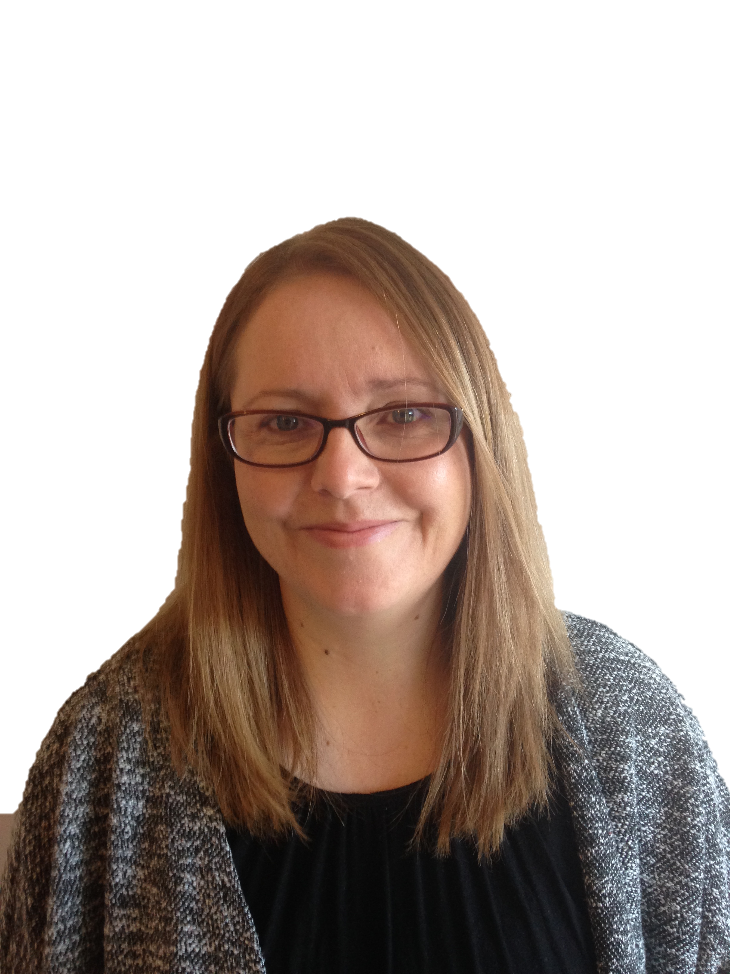


Meet The Staff
Miss Anderson
Y3A Class Teacher
Miss Mackle
Y4CM Class Teacher
Mrs Collinson
Teaching Assistant
Mrs Johnson
PPA Teacher (4CM)
Mr Moore
Y4LM Class Teacher
Mrs Simmons
PPA Teacher (3A & 4LM)
Mrs Reid
Teaching Assistant

Slide 3

Start & Finish Times
CLASSES | START TIME | FINISH TIME
Year 3 Year 4LM Year 4CM | 8.55am Playground gate | 3.15pm Playground gate
Notes:
Social distancing, arrive at allotted times, one parent only, explain footprints, one way system, playtimes – allocated part of the yard/field, parents not on school site-contact by phone or dojo

Slide 4



Mental Health &
Well Being
To support children with settling back into school and our new routines, we will be delivering more personal, social, health and emotional (PSHE) sessions.
When answering the register, children may choose to respond with a colour linking to how they are feeling that day.

Slide 5
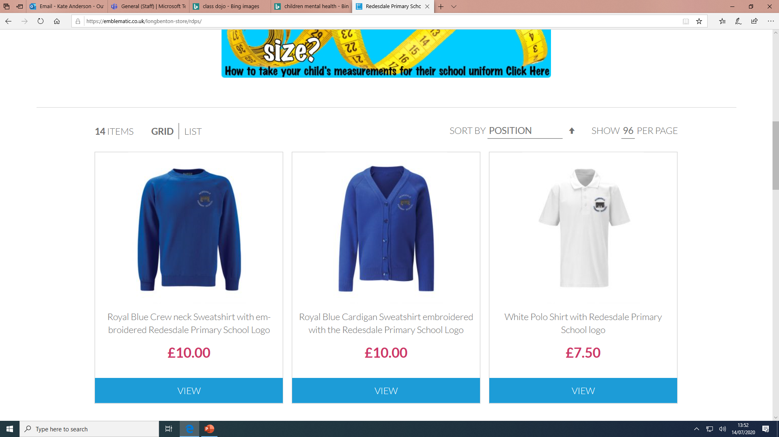
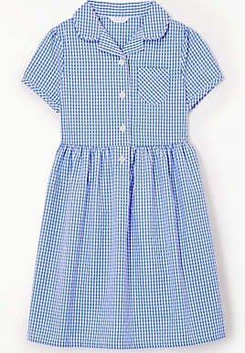
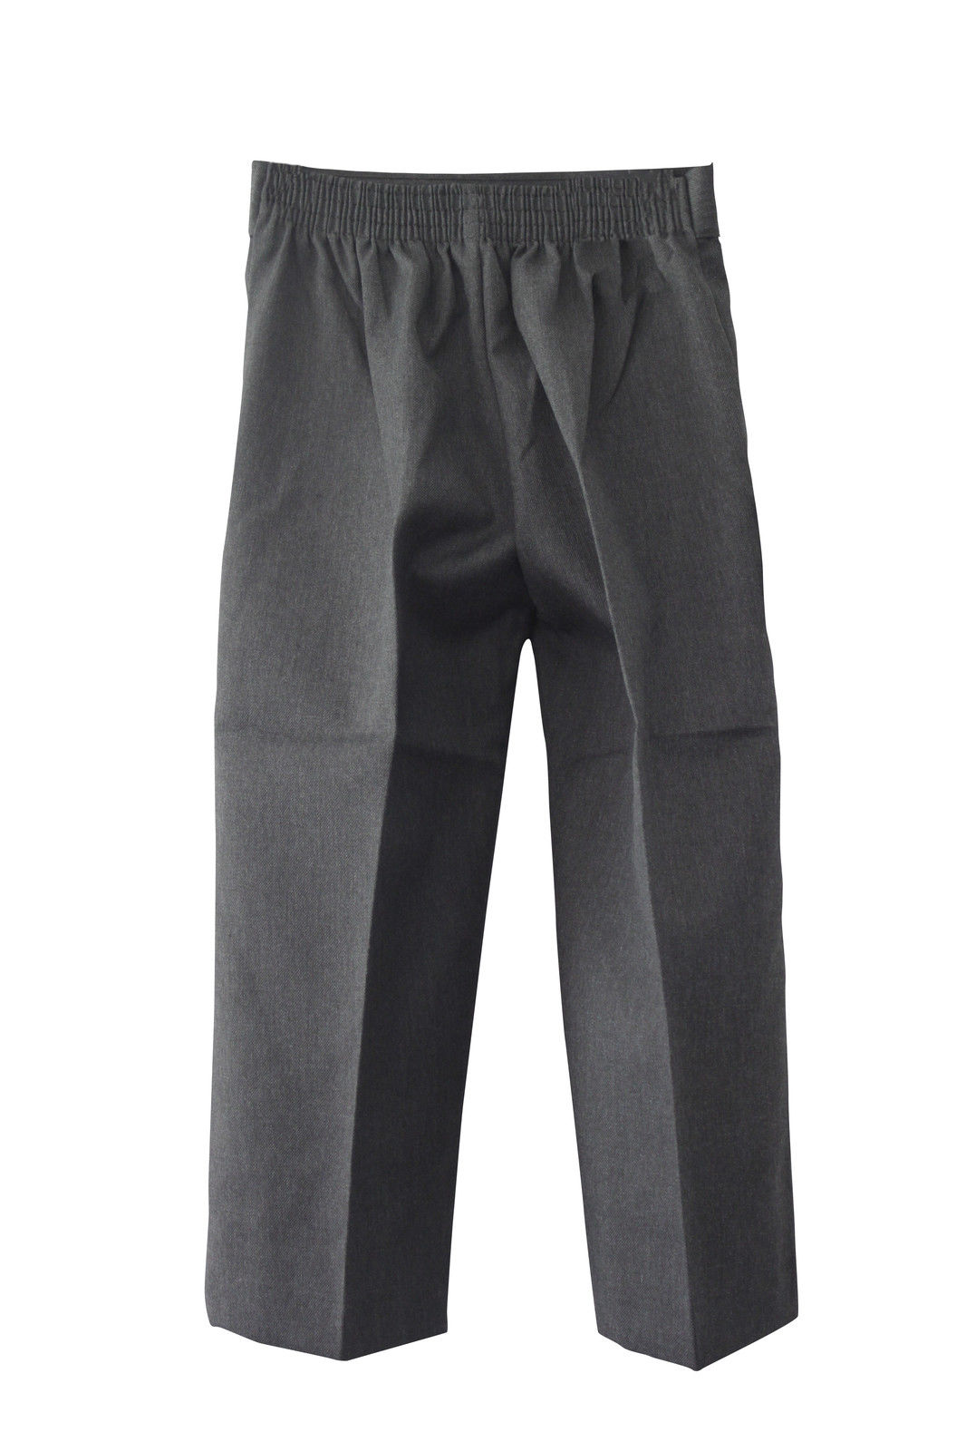
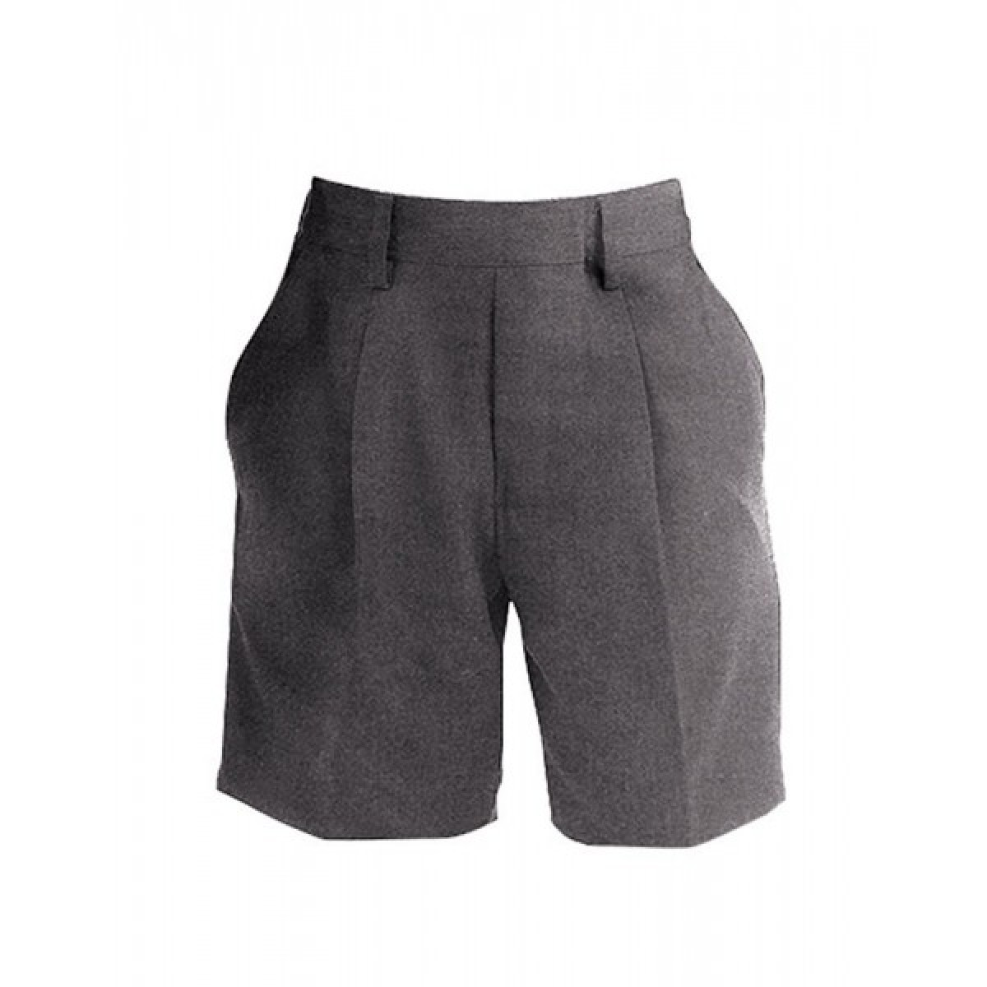
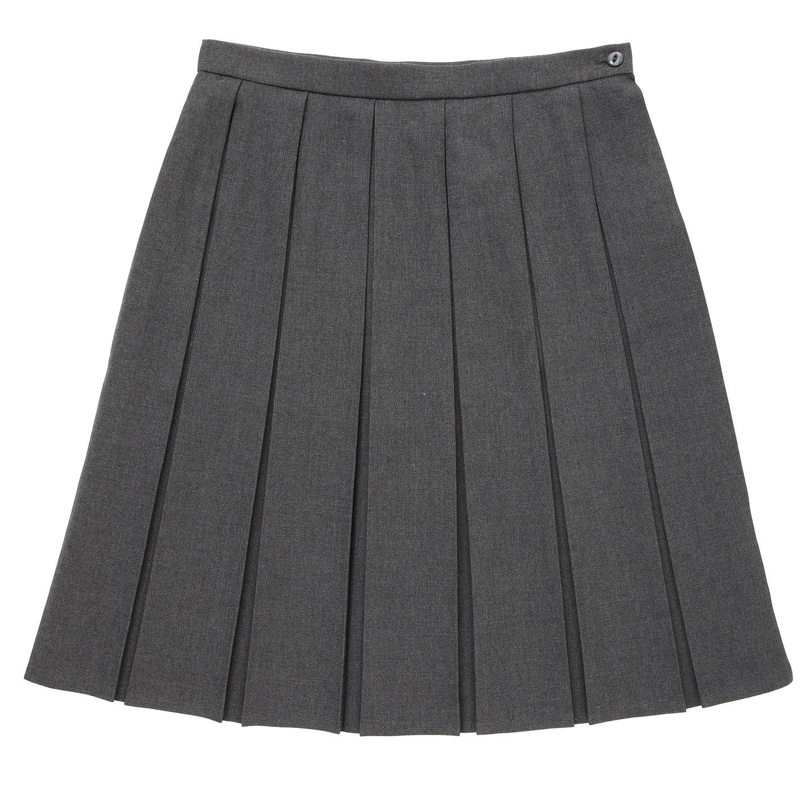
Expectations
All children to wear the correct school uniform.
Children with long hair must have it tied back.
Jewellery is not allowed in school.
Nail varnish is not to be worn in school.
We are preparing the children to be much more independent in class by expecting them to take responsibility for the above.

Slide 6
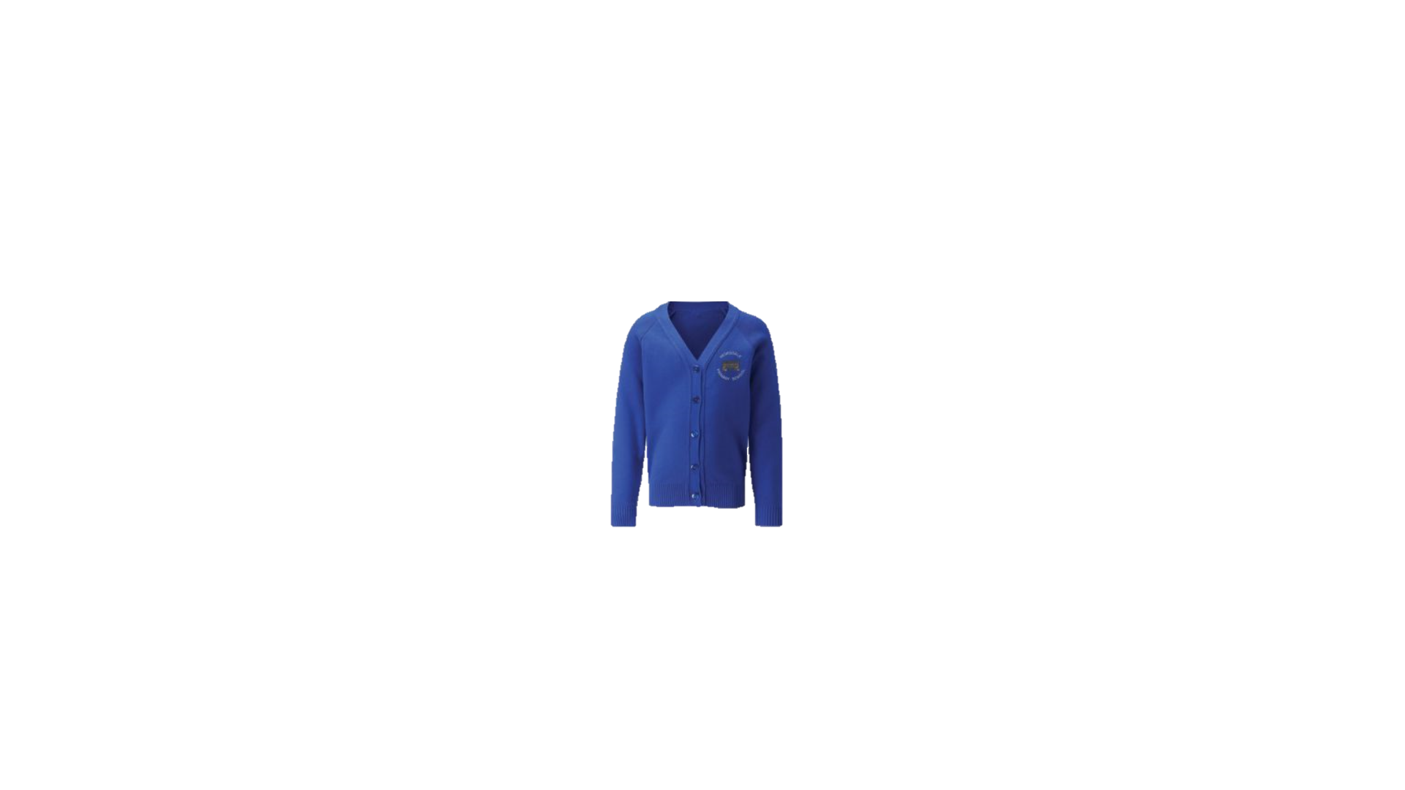
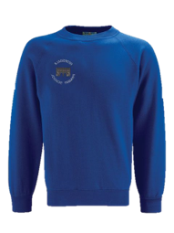
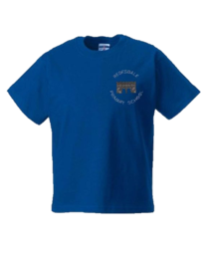
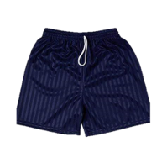
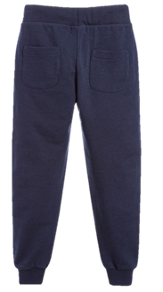

PE
Children will come into school on their PE day wearing their PE Kit.
Every child must have the correct kit for PE
(navy shorts, royal blue t-shirt and trainers with non-marking soles)
Children MUST NOT wear their school shoes for PE, they must have separate non-marking sole trainers.
Earrings are not permitted on PE days. Plasters CANNOT be used to cover earrings – this is in line with our school policy.
The children will be outdoors for PE as much as possible – they can wear navy blue plain tracksuit bottoms as part of their kit.

Slide 7

Behaviour
We are PROUD to be at Redesdale Primary School and have 5 key rules:
Polite ​
Respect​
Open and honest​
Understanding​
Do our best​
Children are rewarded for positive behaviour through our Class Dojo school system.
Notes:
Phase bubbles

Slide 8

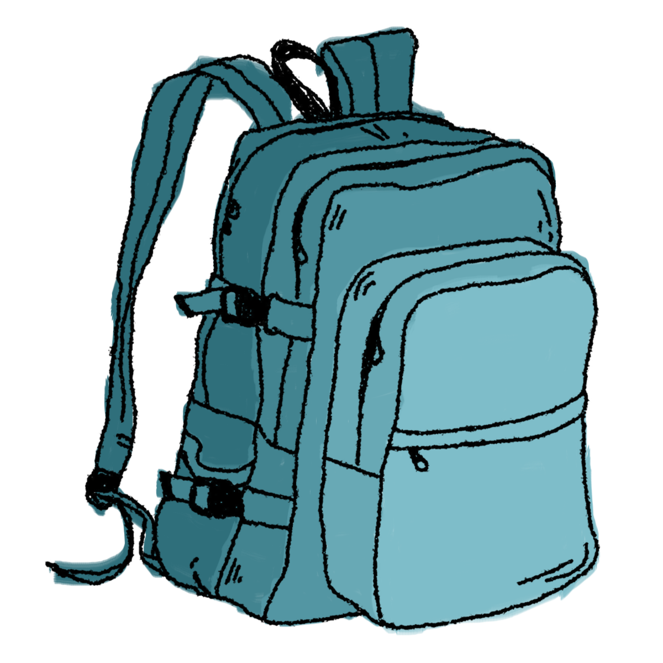

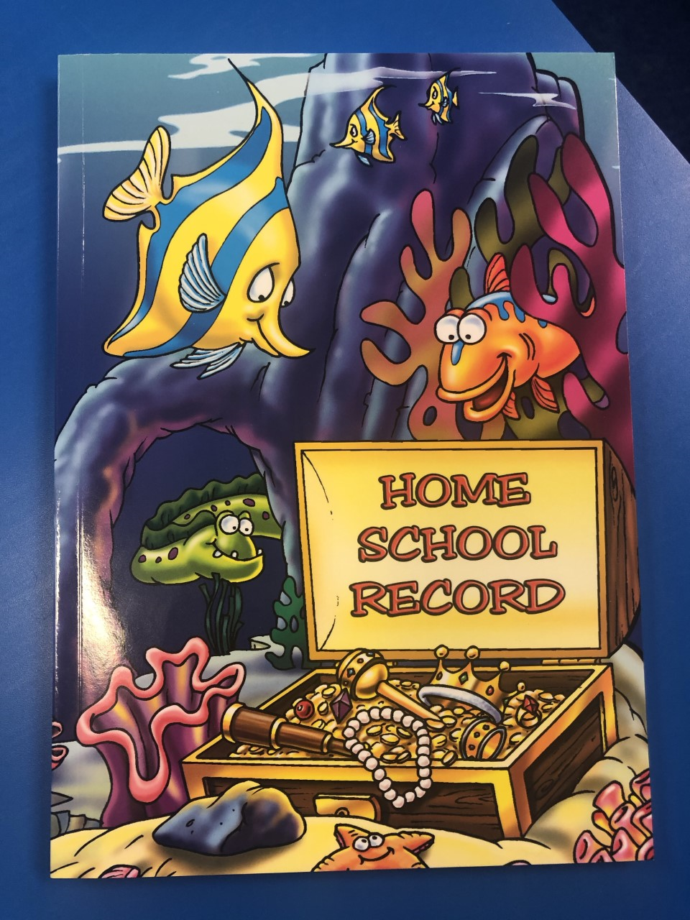

School Bags
All children should bring a bag to school with them each day to carry all of their belongings:
COAT
Water bottle
Packed lunch (if applicable)
Home Learning Diary
Reading book
Sun cream (when necessary)
PLEASE ENSURE ALL ITEMS ARE CLEARLY NAMED
Notes:
No backpacks or toys

Slide 9
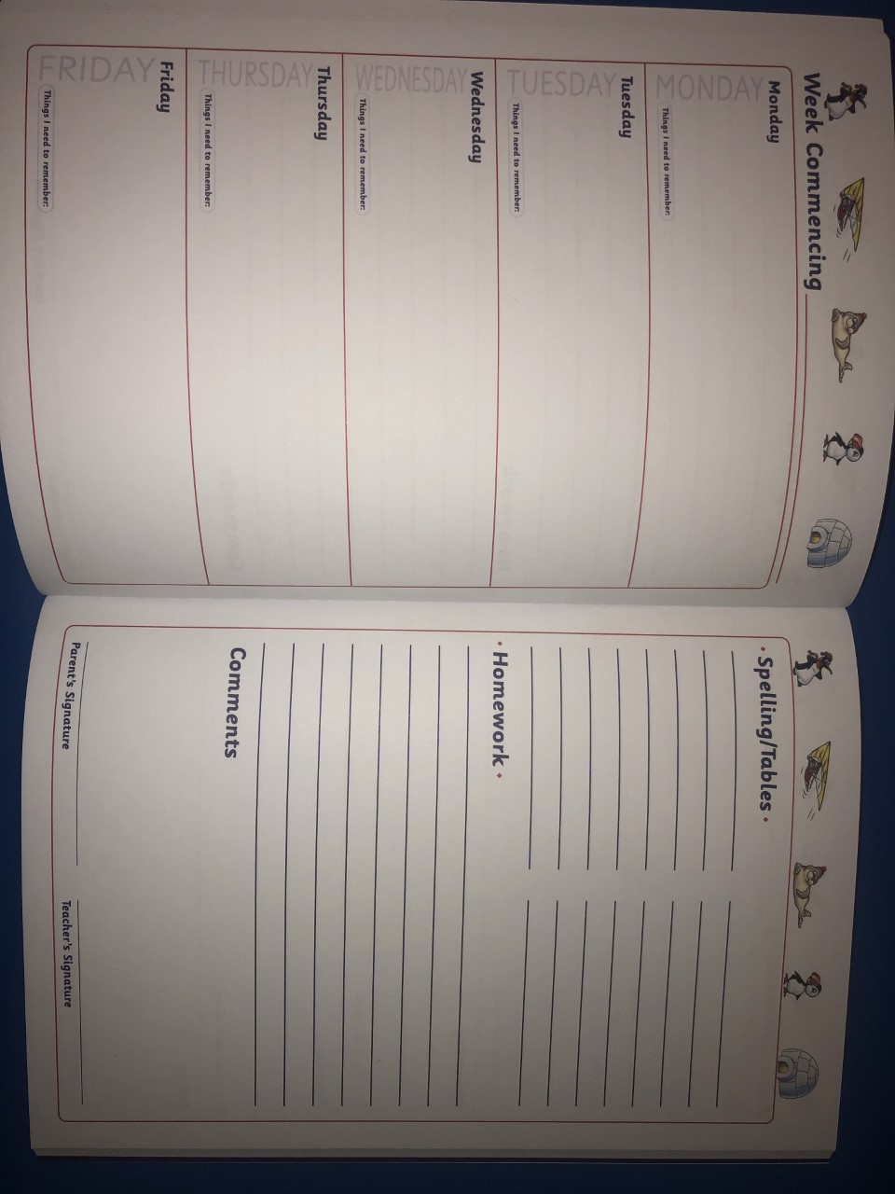
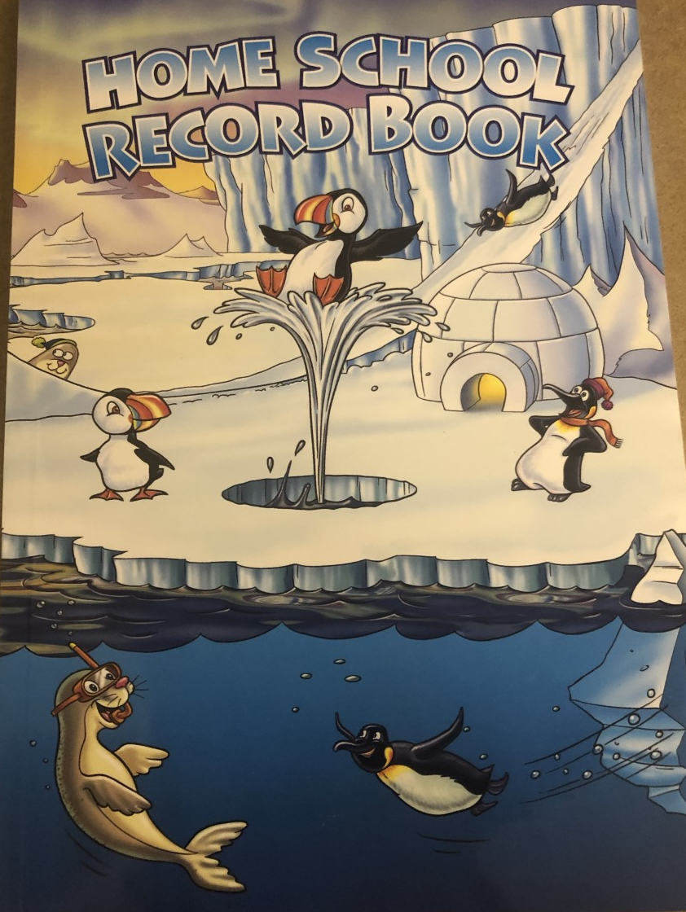
Home Learning Diary
Home learning diaries MUST be in school EVERYDAY.
Support your child with reading at home and encourage them to record their reading in their diary on the correct day.
Children will record their spellings and times table test results in their diary.
Dojo points will be rewarded for reading at home.
Notes:
Come to school in PE kit – spare white soled trainers for PE

Slide 10

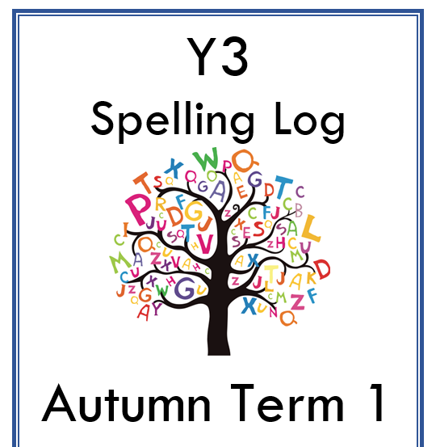

Home Learning
Reading
Times Table Rock Stars
Spellings (optional additional home learning)

Slide 11
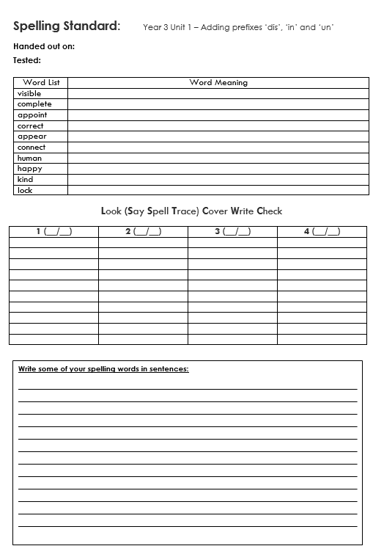
Spelling Log
We will work on a series of spellings from Monday-Thursday for 15 minutes each day in school.
The spelling words will also be posted on Class Dojo on a Monday.
Spelling Logs activities are completed in class each day.
The spelling test will take place on a Friday morning and will be recorded in Home Learning Diaries.

Slide 12
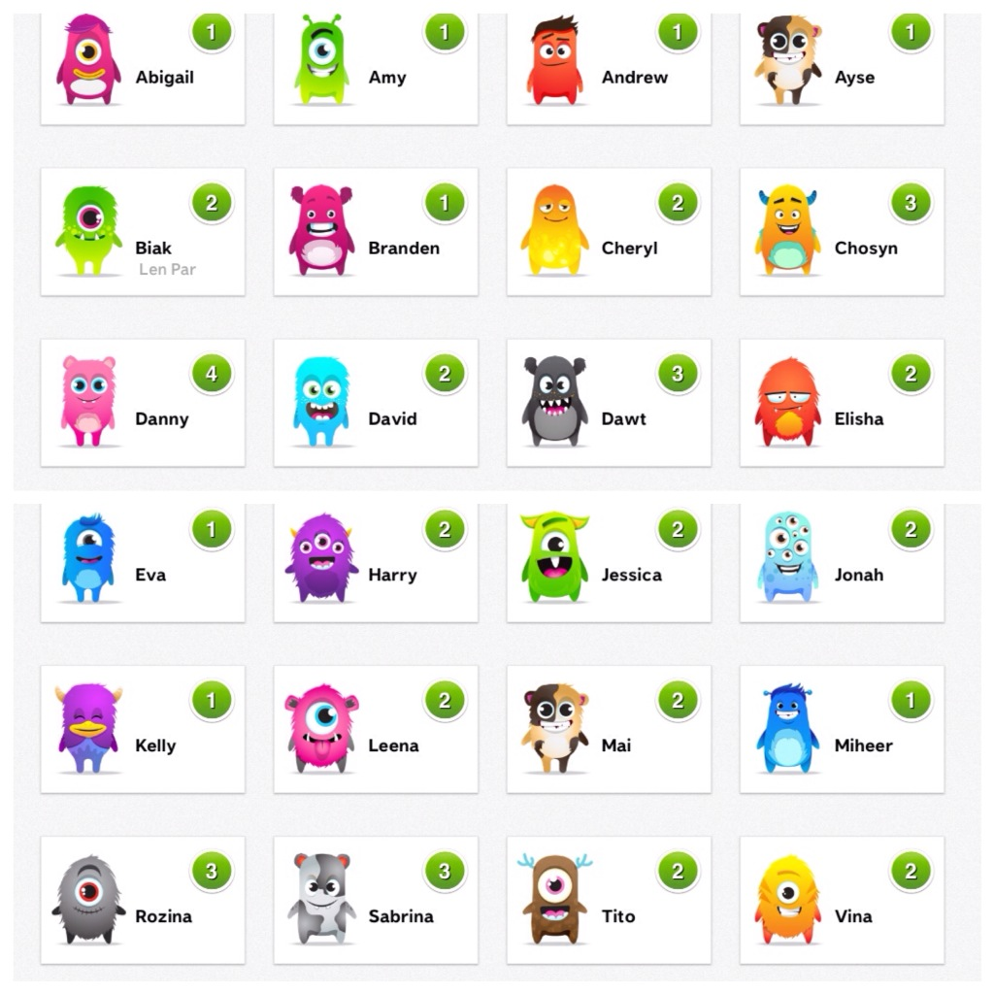
Class Dojo
Please ensure you are connected to Class Dojo and have your notification switched on to get all the latest class updates!
Find out why they get positive dojo points.
Send/receive messages to teachers.
See what we do in class via Class Story.
Get instant up dates about school events.
If parents wish to contact a member of school staff, this must be done via Class Dojo or Telephone.

Slide 13
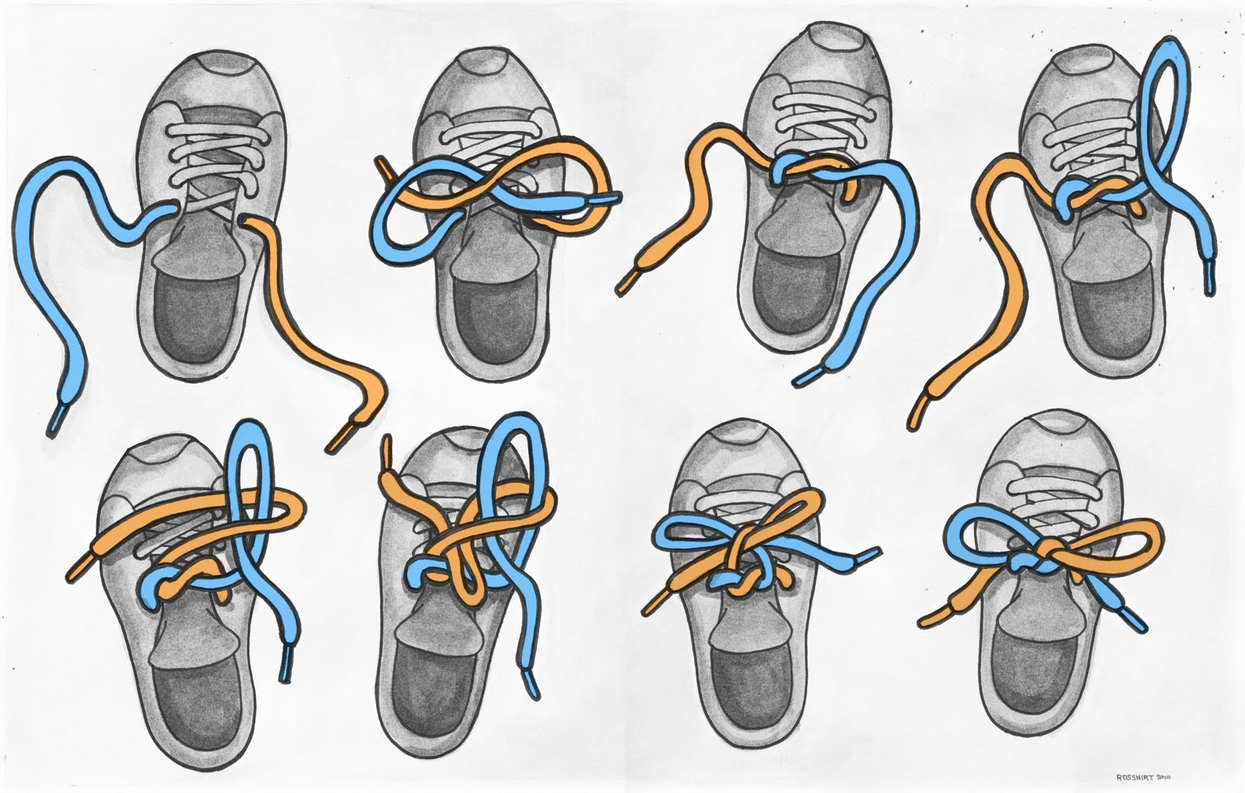
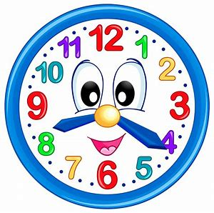
Skills to work on at home
In KS2 we actively promote independence.
It would be helpful for pupils to learn how to:
Tie their shoe laces
Draw straight lines using a ruler
Cut out neatly with scissors
Tell the time on a digital and analogue clock

Slide 14
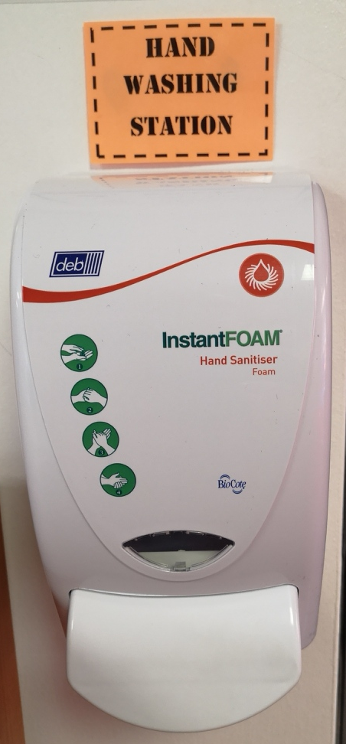

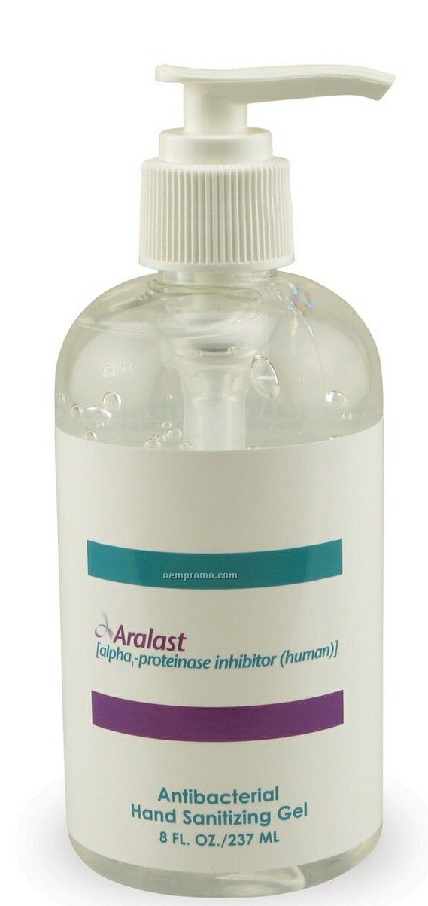
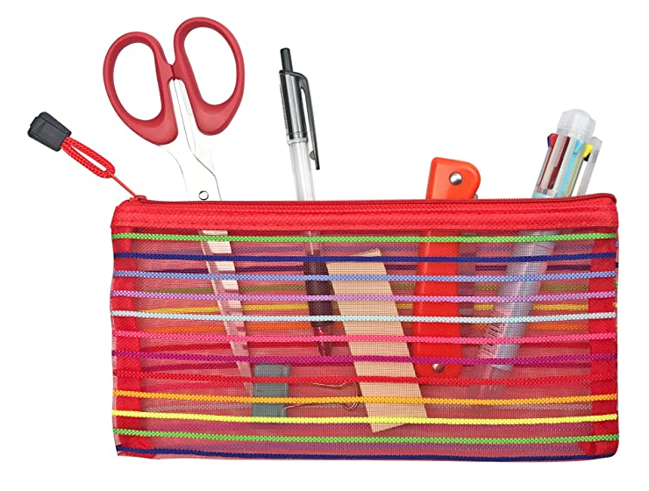
Personal Hygiene
Regular handwashing
Hand sanitising
Own equipment
Notes:
Phase bubbles

Slide 15
Please note that the information provided in this presentation may be subject to change over the Summer Holidays due to Department for Education (DfE) Guidance. We ask you for your patience and understanding as we work to meet the needs of the children using the most up-to-date information.
Should we need to inform you of any changes prior to September, we will contact you using our usual channels of communication - Class Dojo and Parent Mail.

